Slide 1
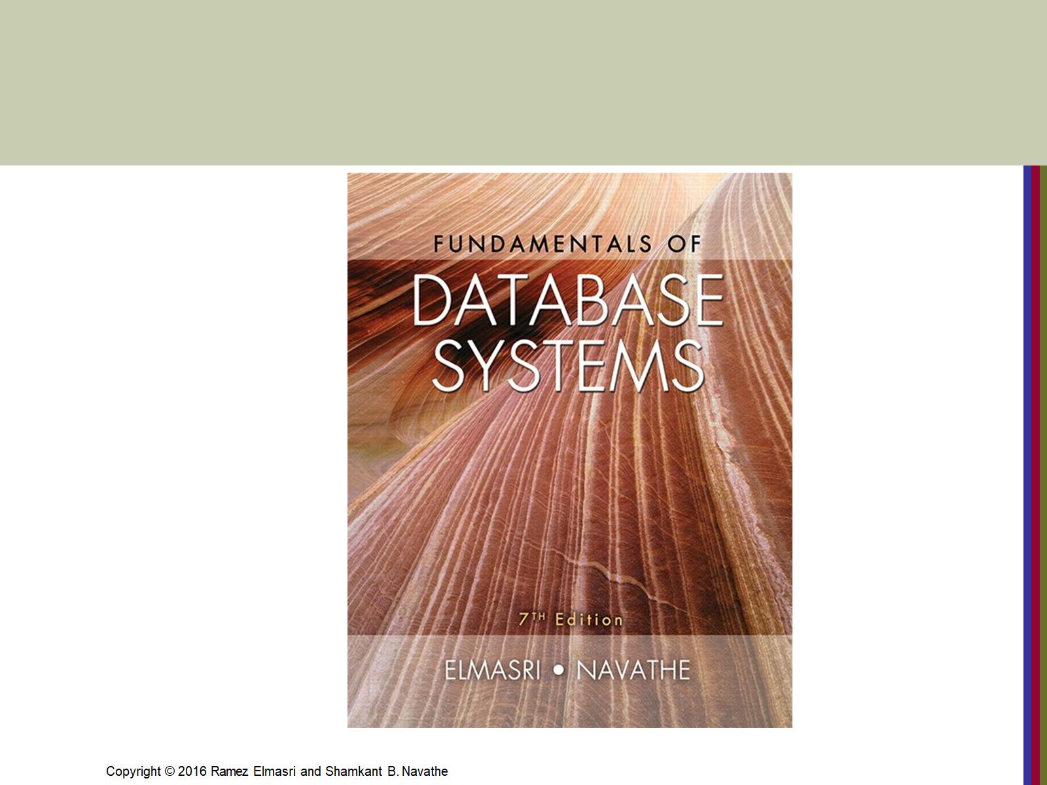

Slide 2
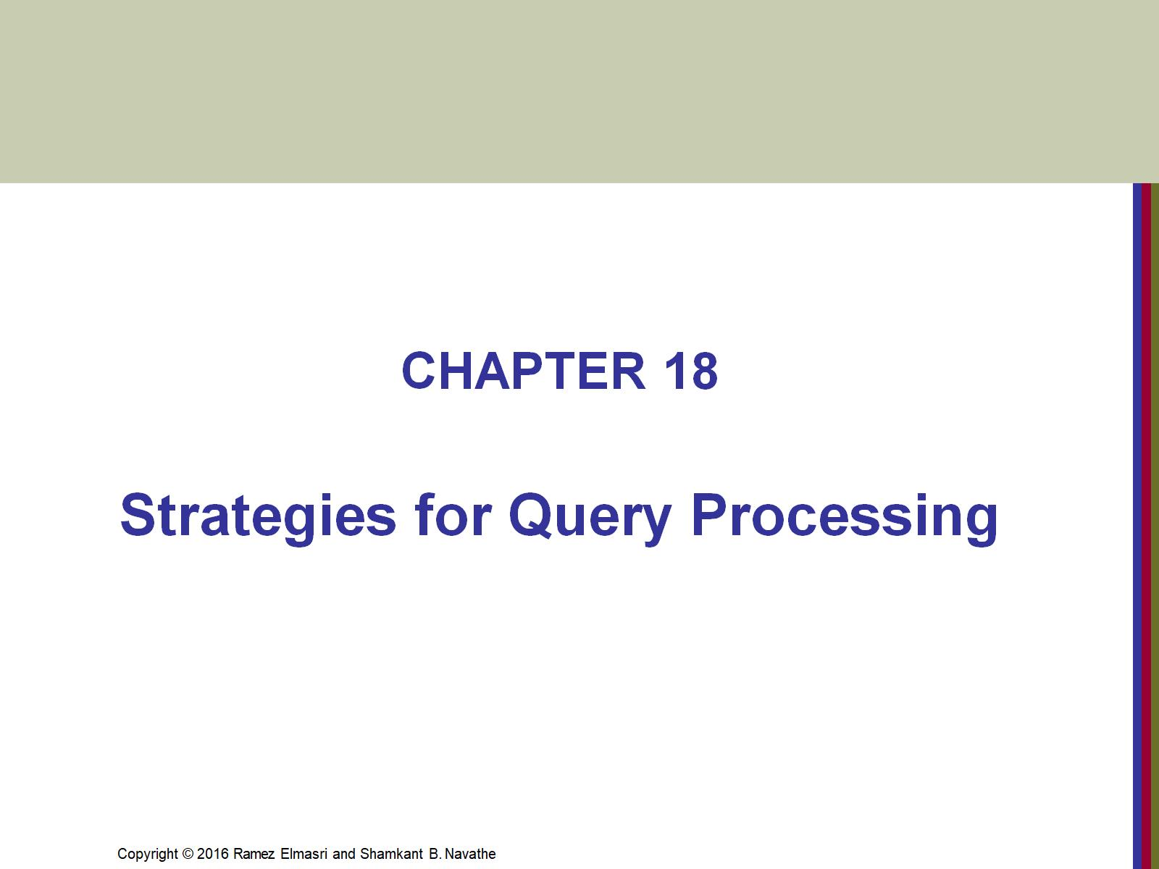

Slide 3
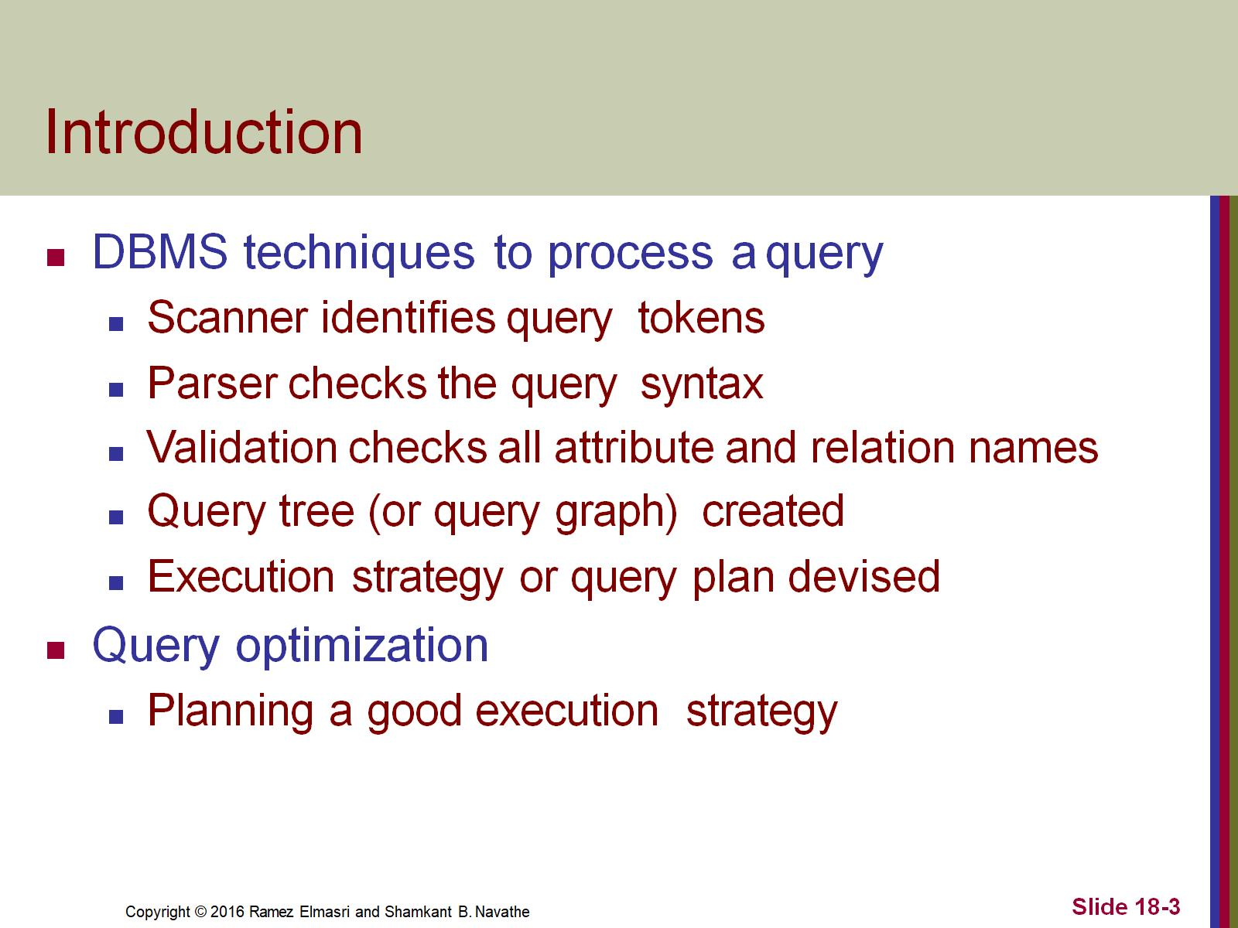
Introduction

Slide 4
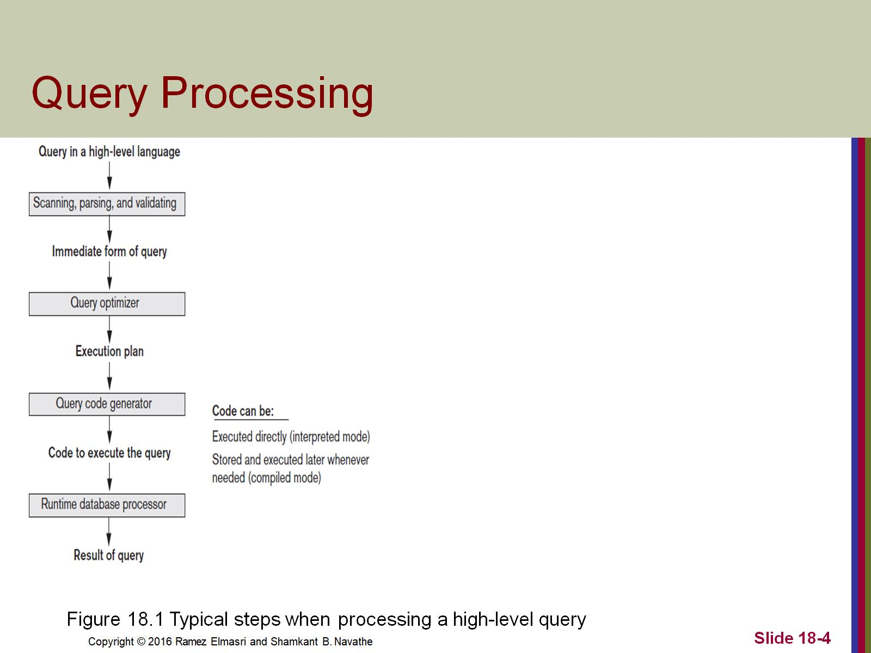
Query Processing

Slide 5
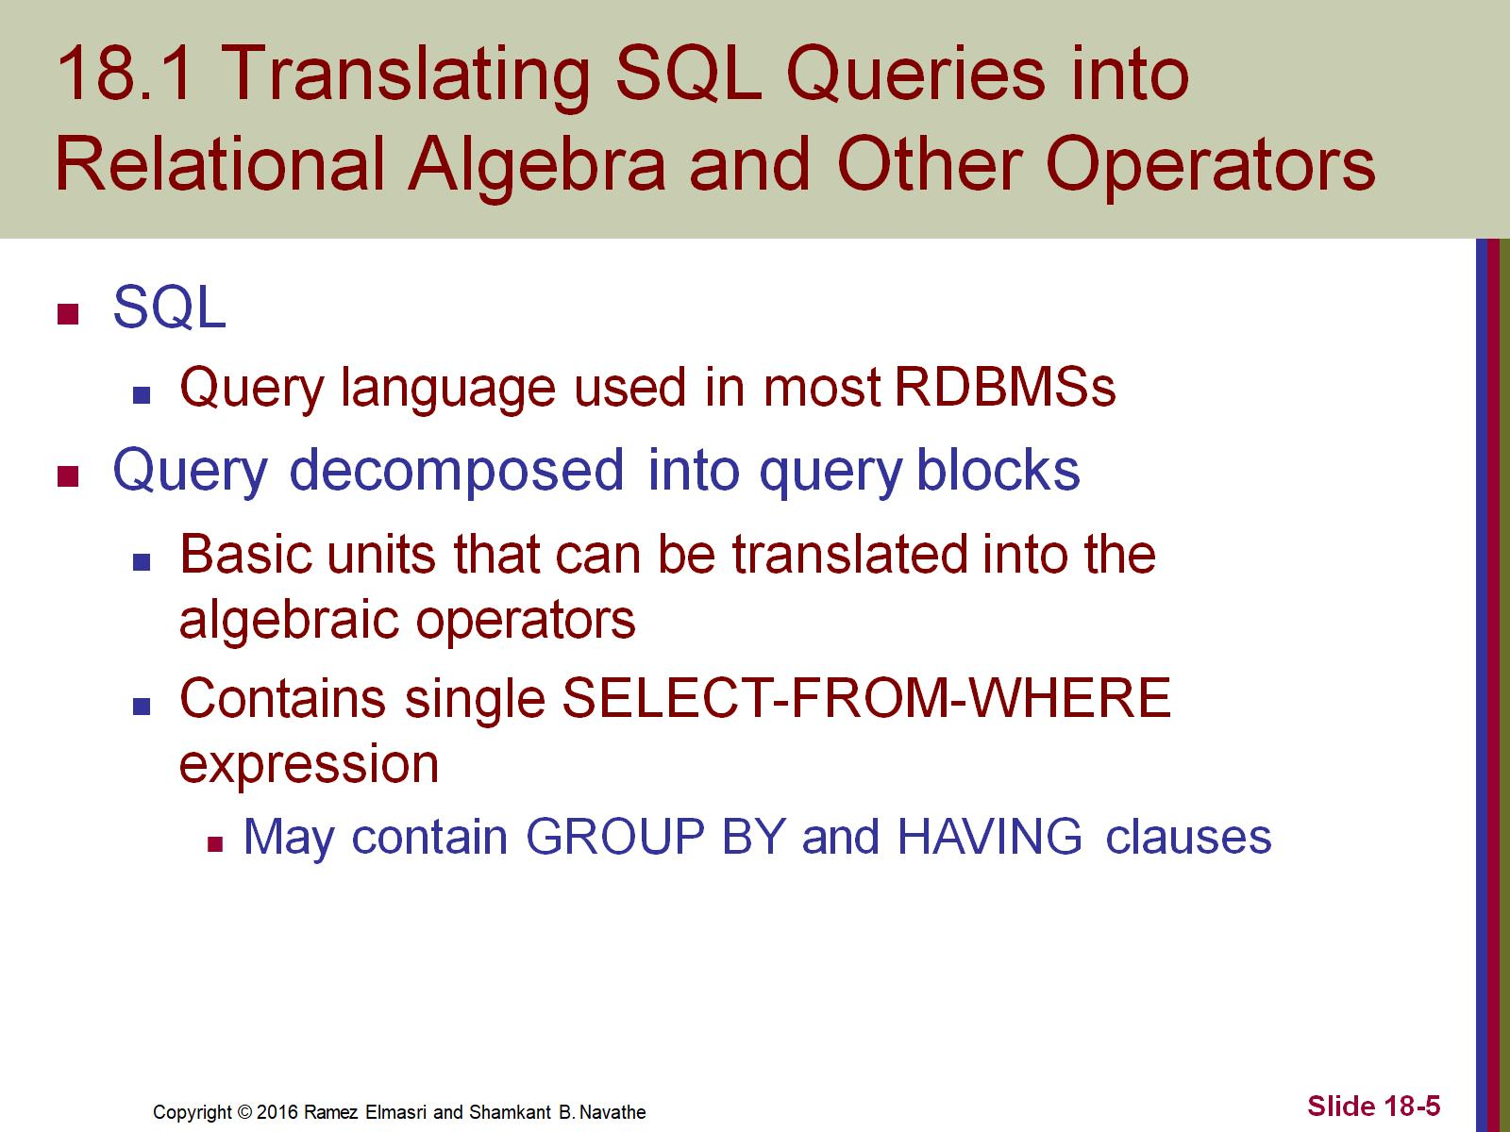
18.1 Translating SQL Queries into Relational Algebra and Other Operators

Slide 6
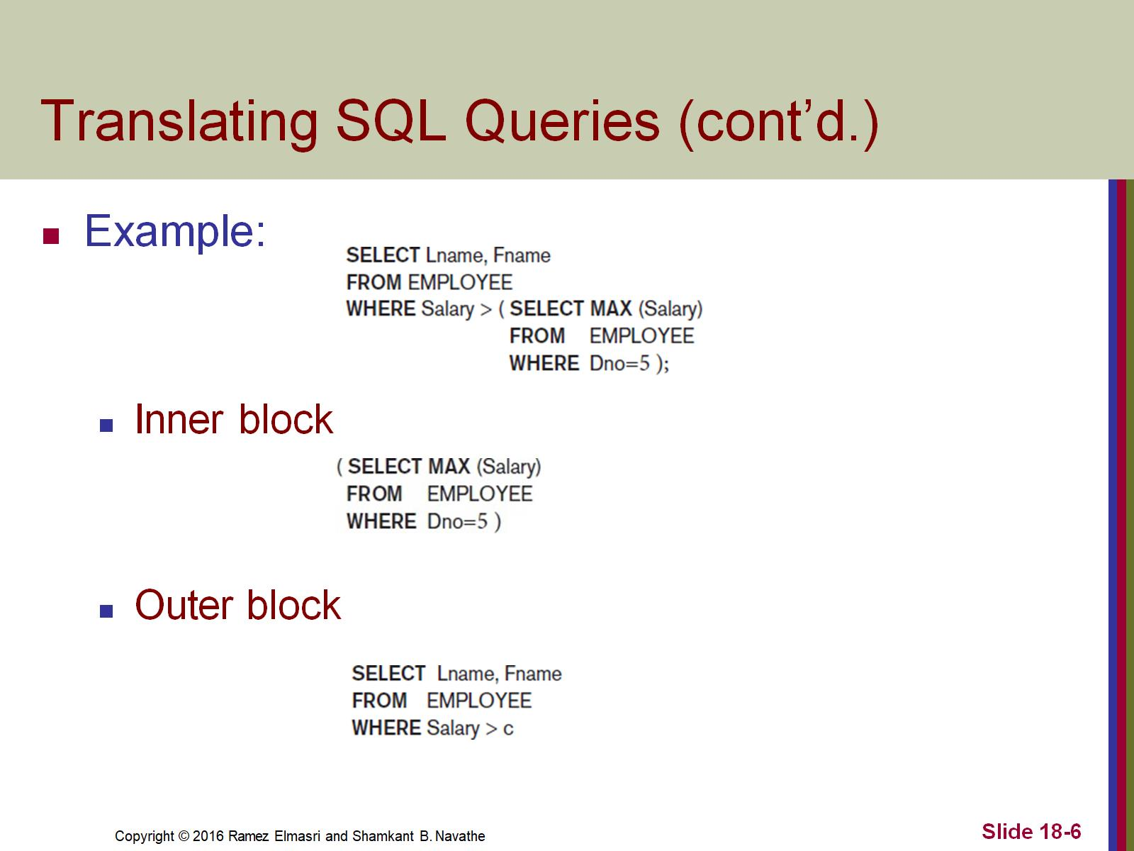
Translating SQL Queries (cont’d.)

Slide 7
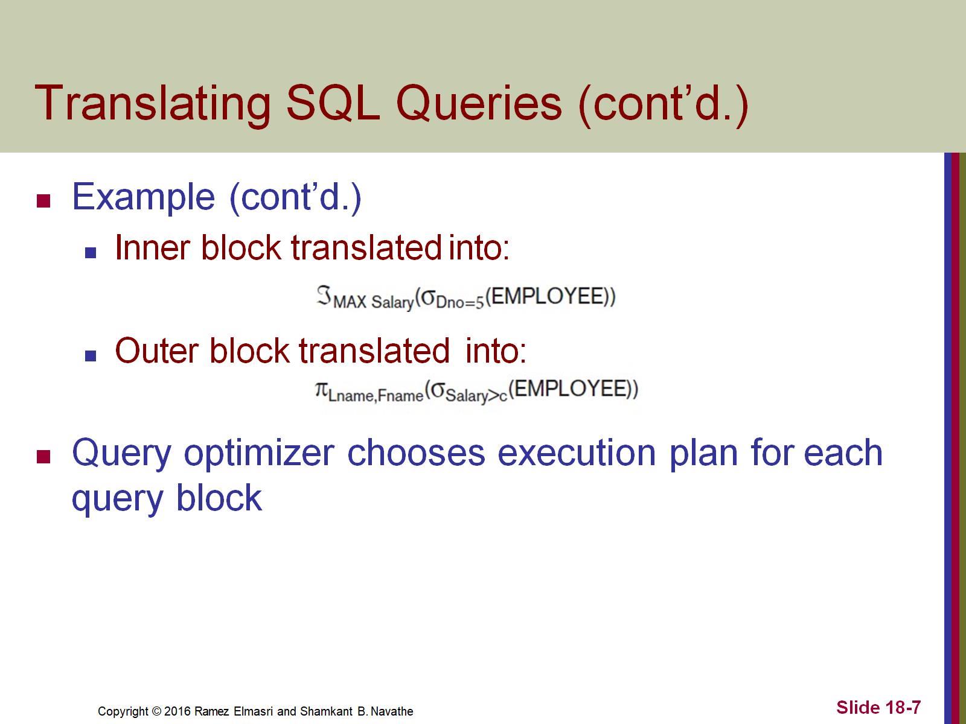
Translating SQL Queries (cont’d.)

Slide 8
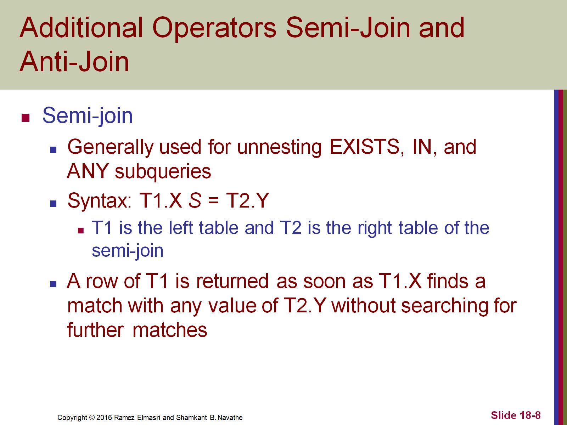
Additional Operators Semi-Join and Anti-Join

Slide 9
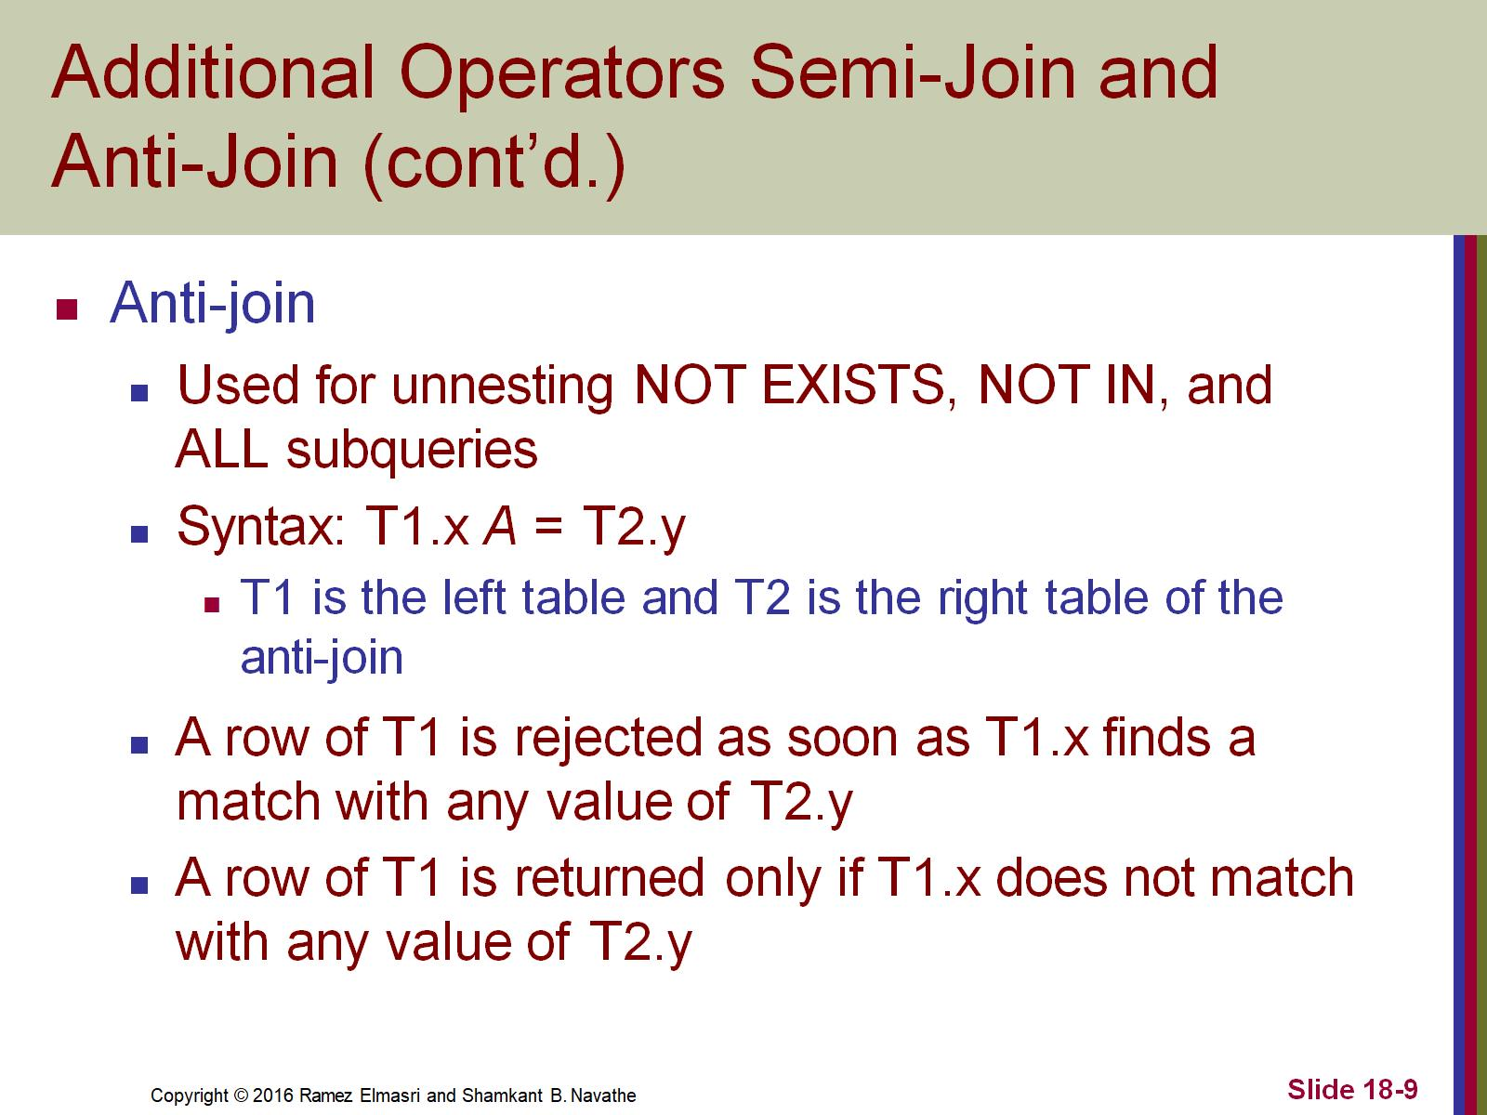
Additional Operators Semi-Join and Anti-Join (cont’d.)

Slide 10
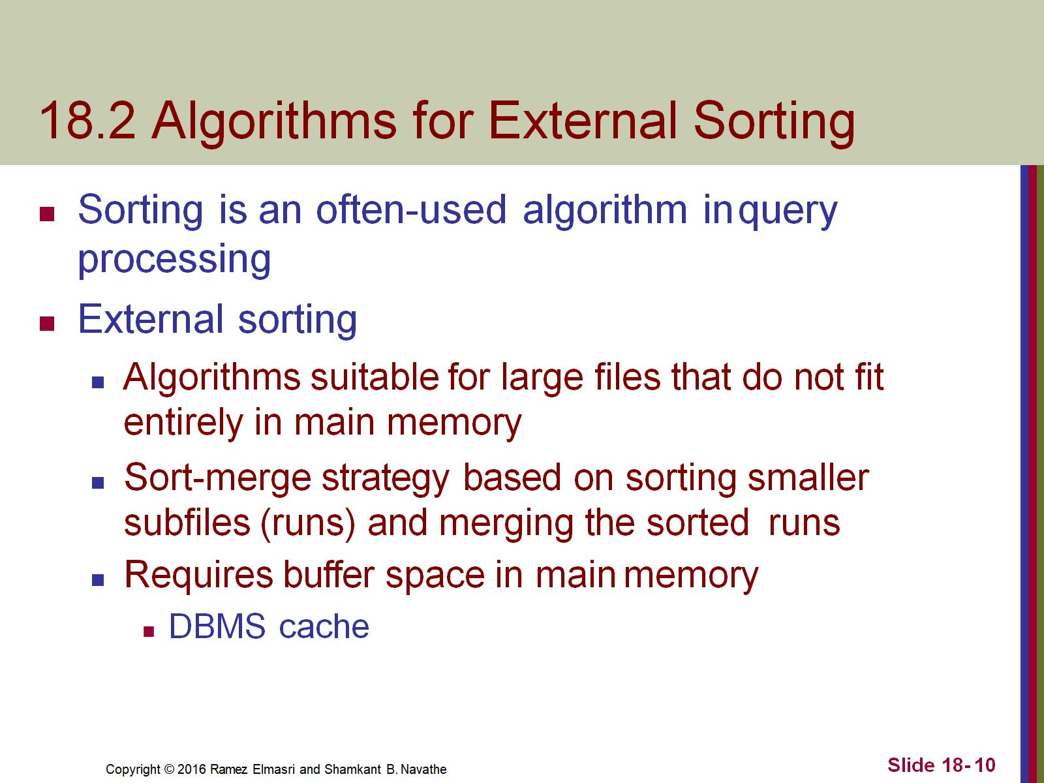
18.2 Algorithms for External Sorting

Slide 11
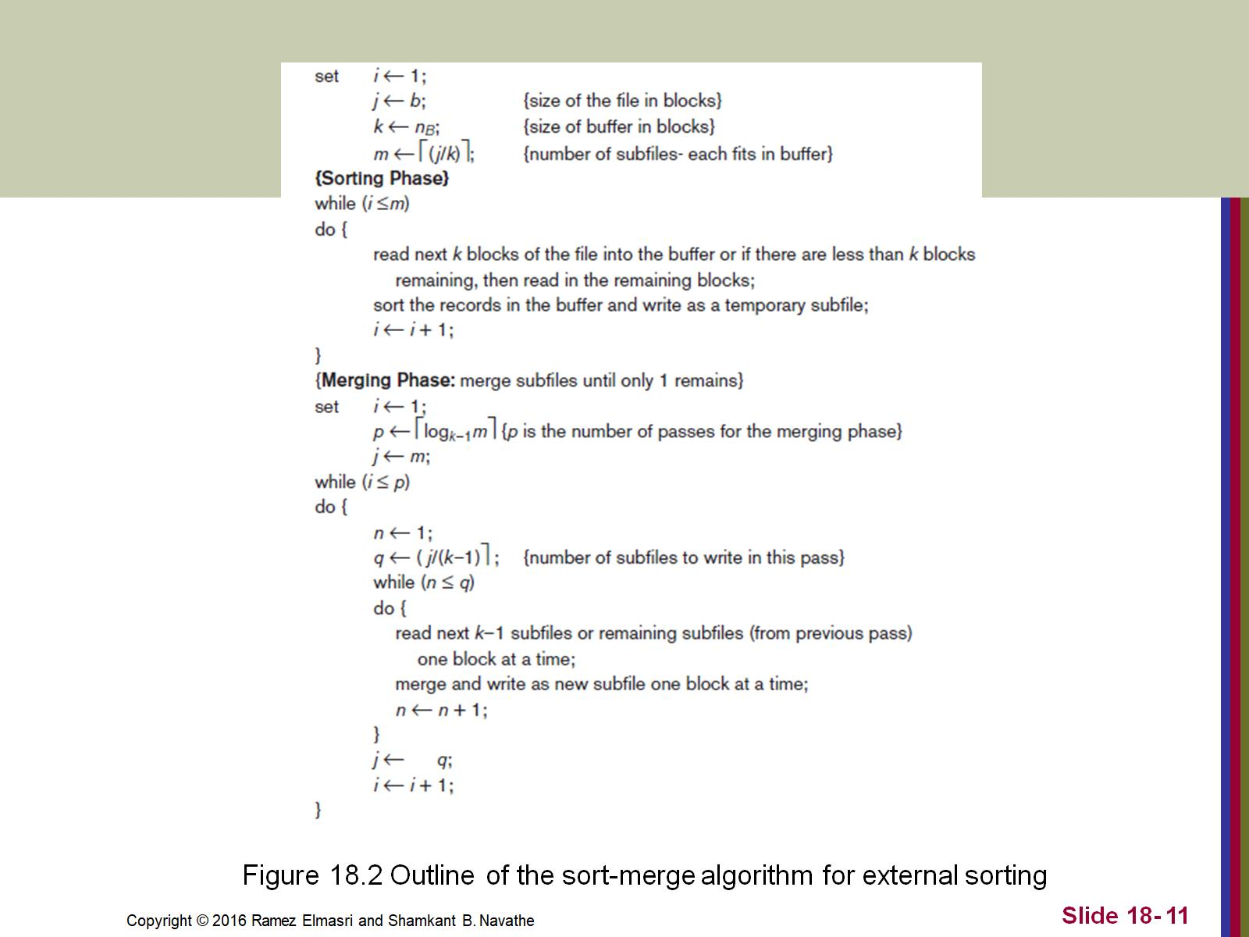

Slide 12
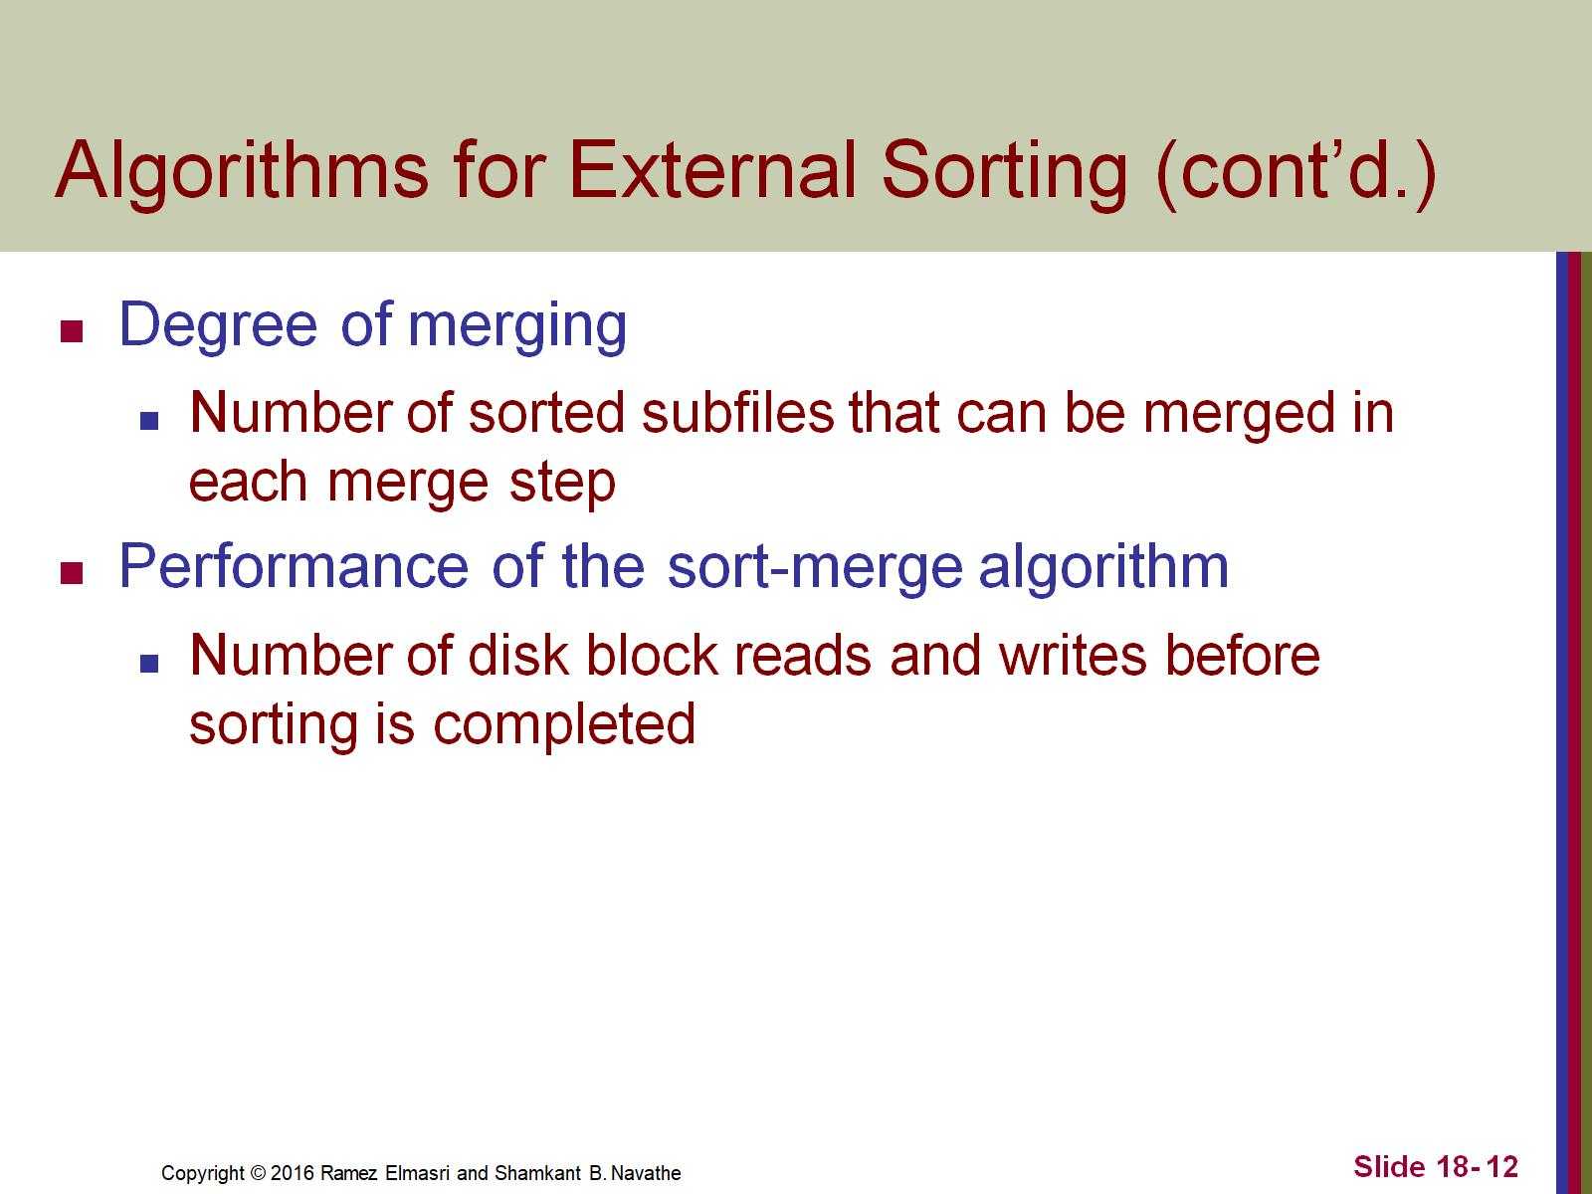
Algorithms for External Sorting (cont’d.)

Slide 13
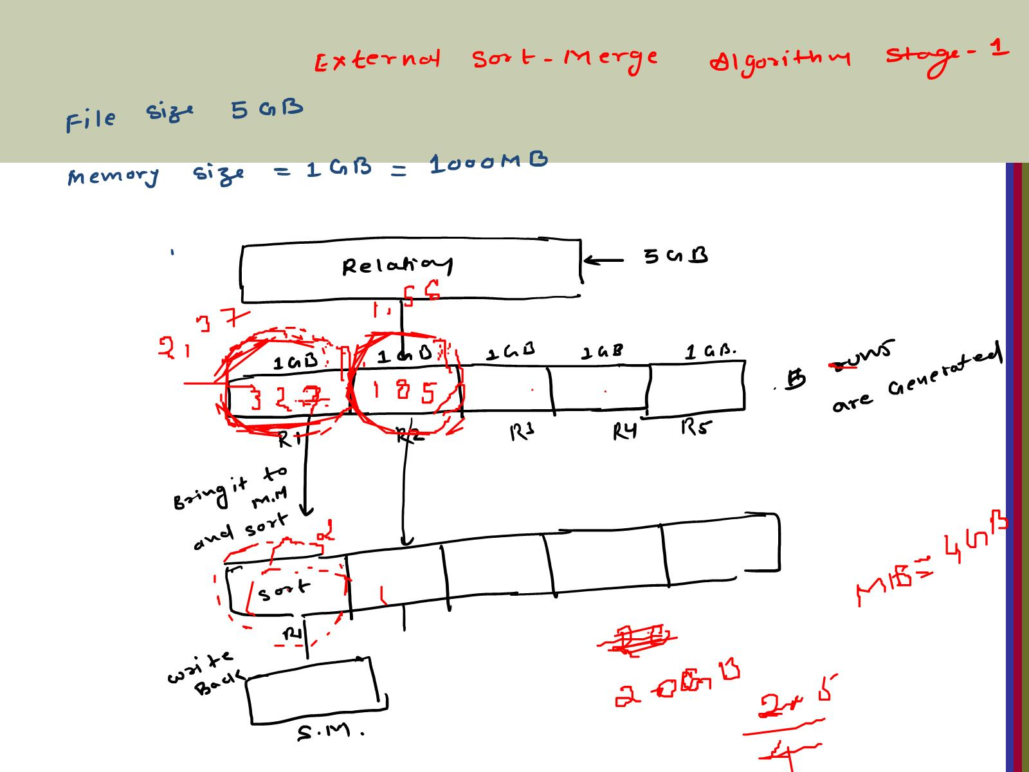

Slide 14
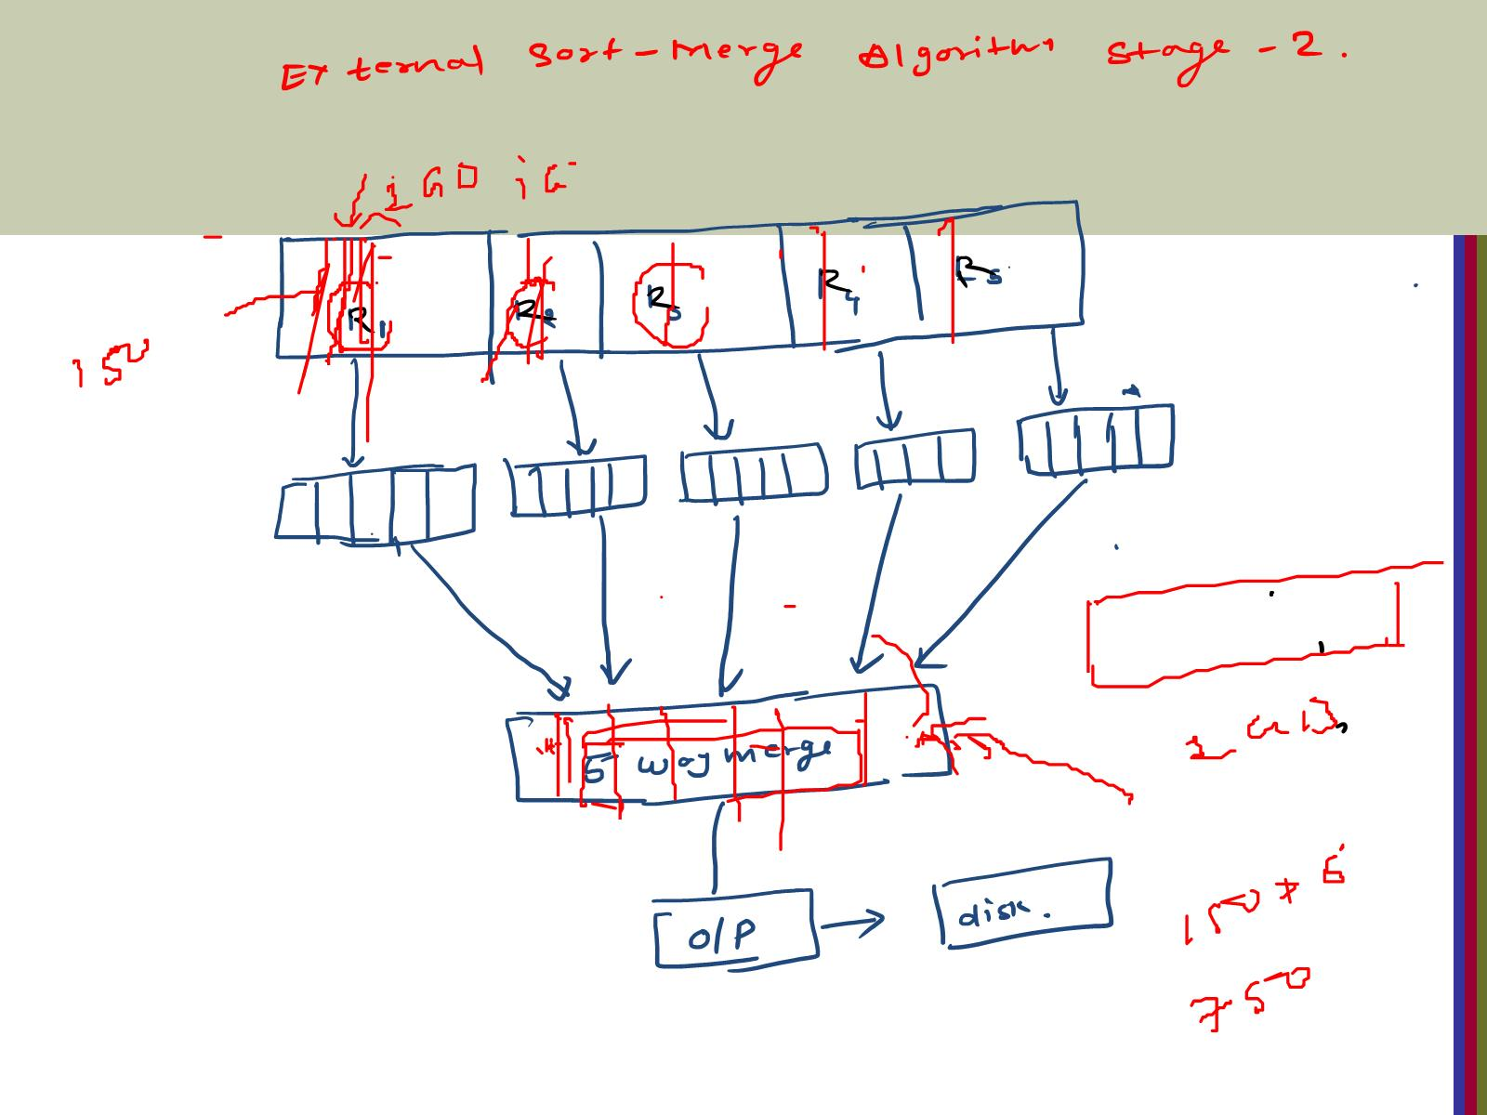

Slide 15
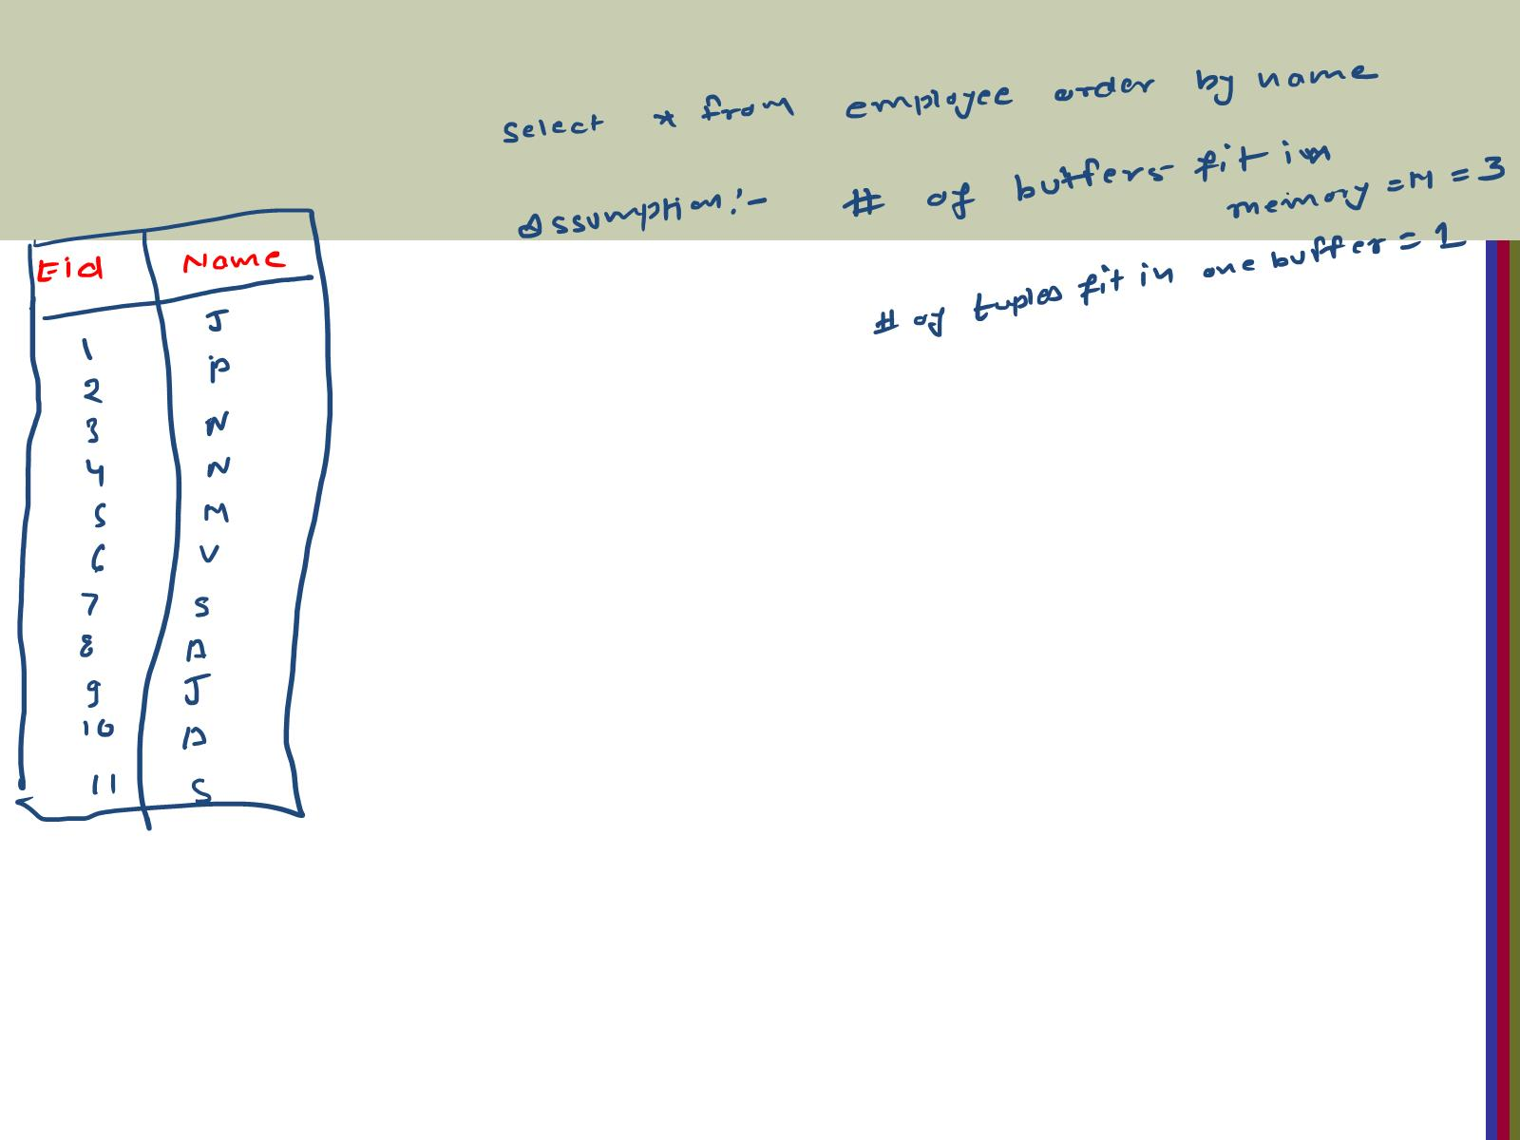

Slide 16
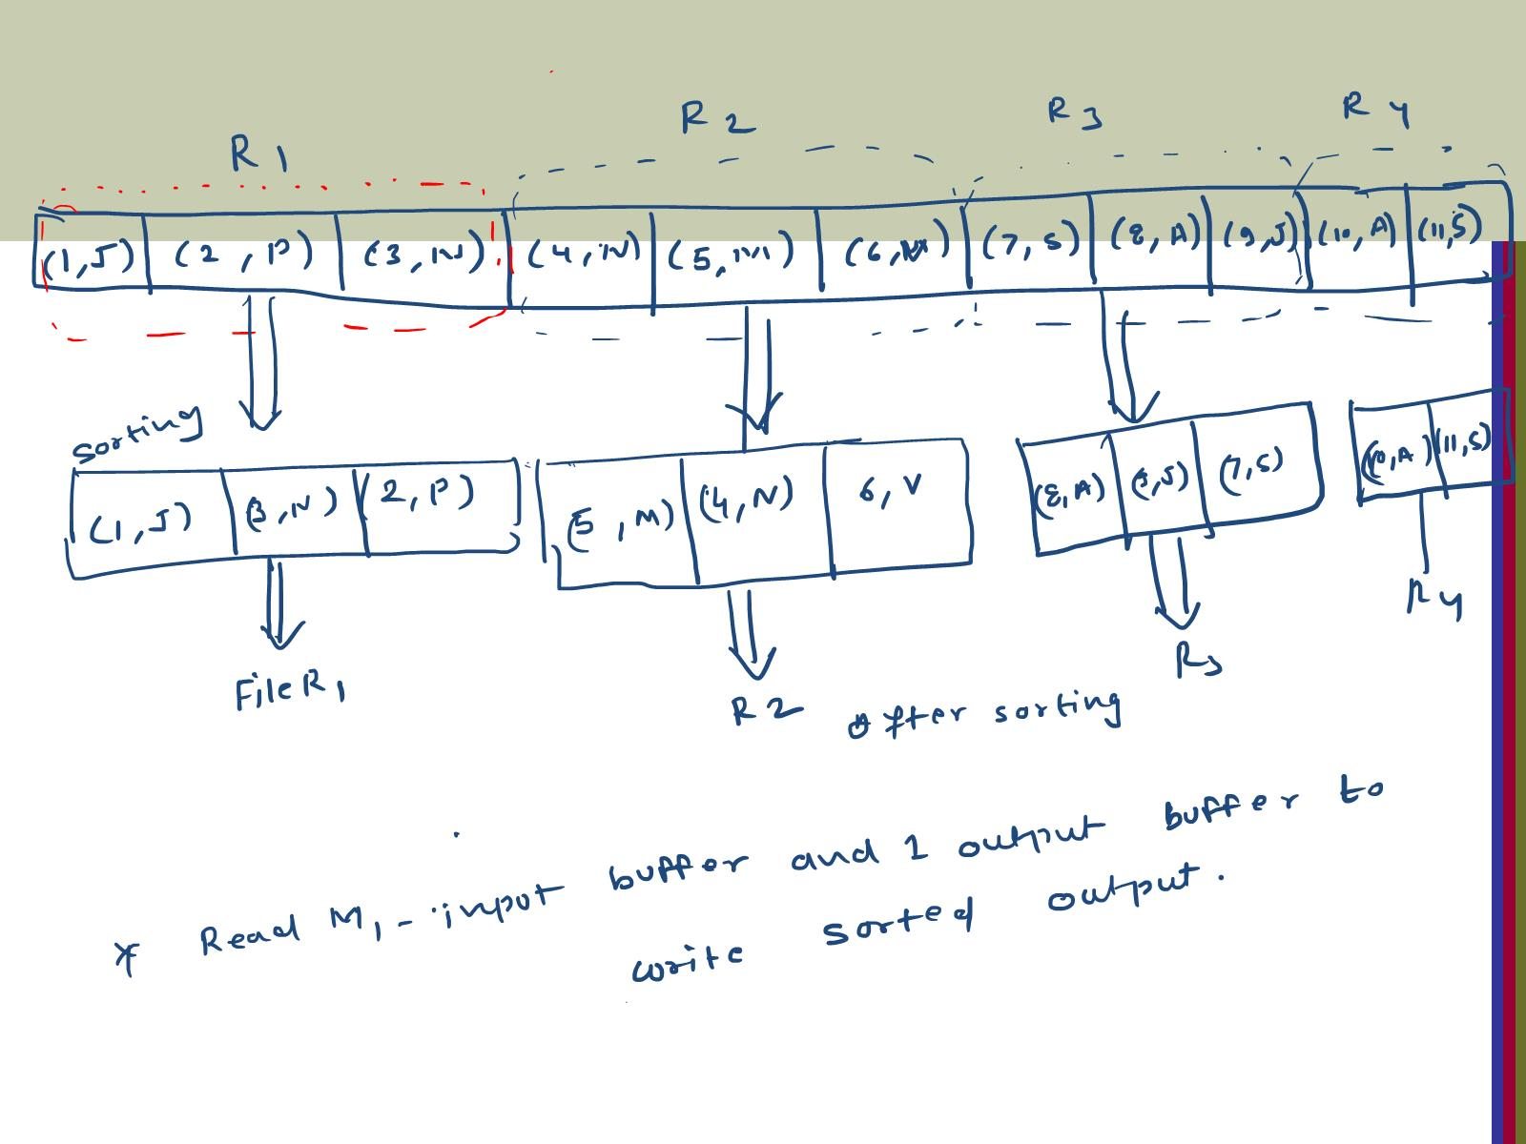

Slide 17
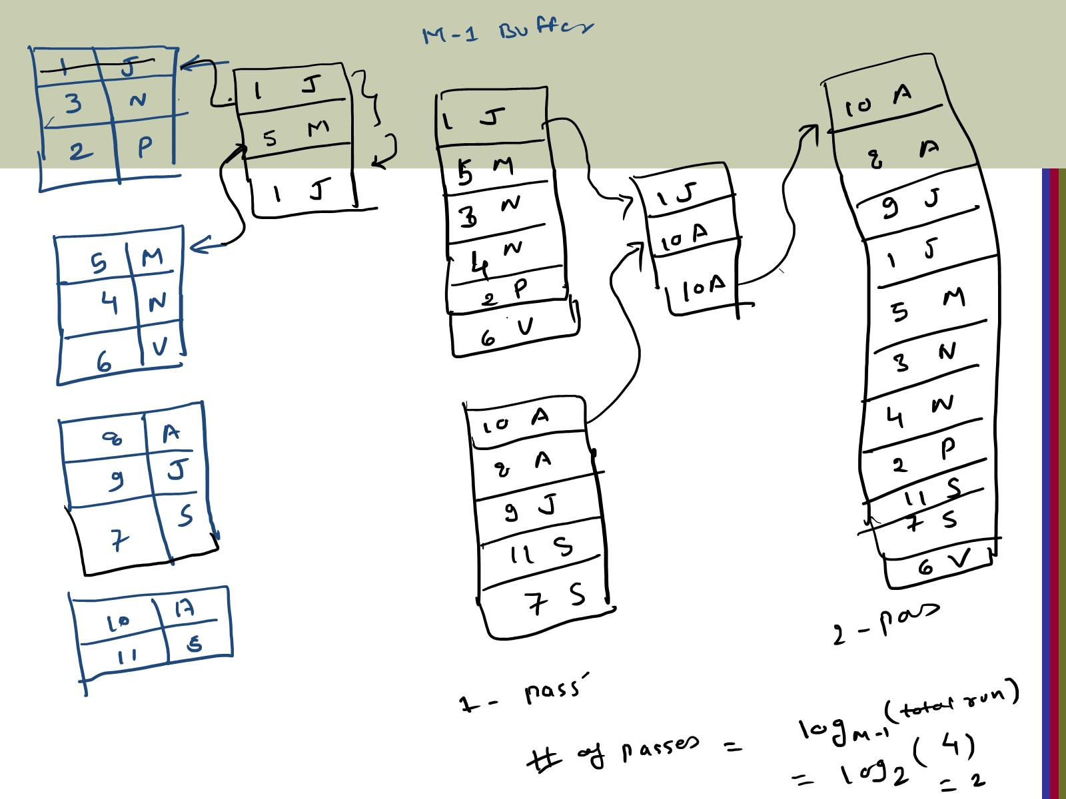

Slide 18
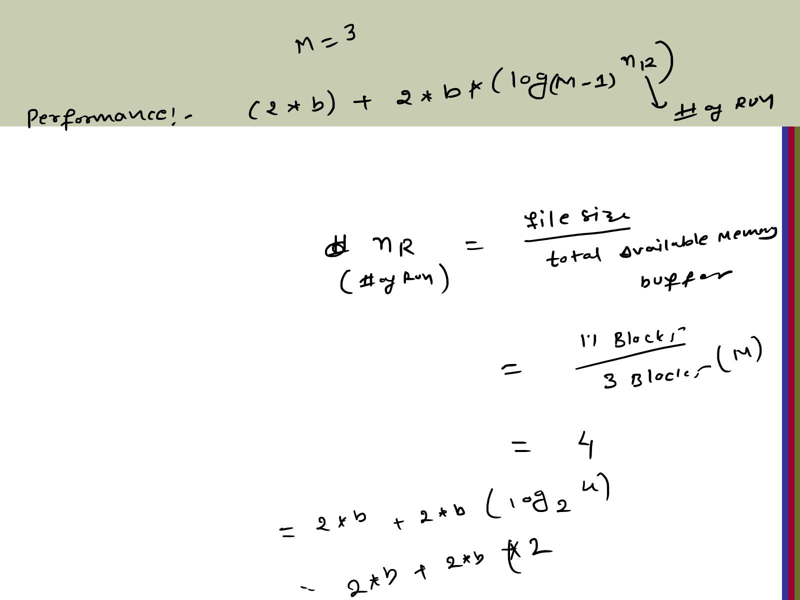

Slide 19


Slide 21
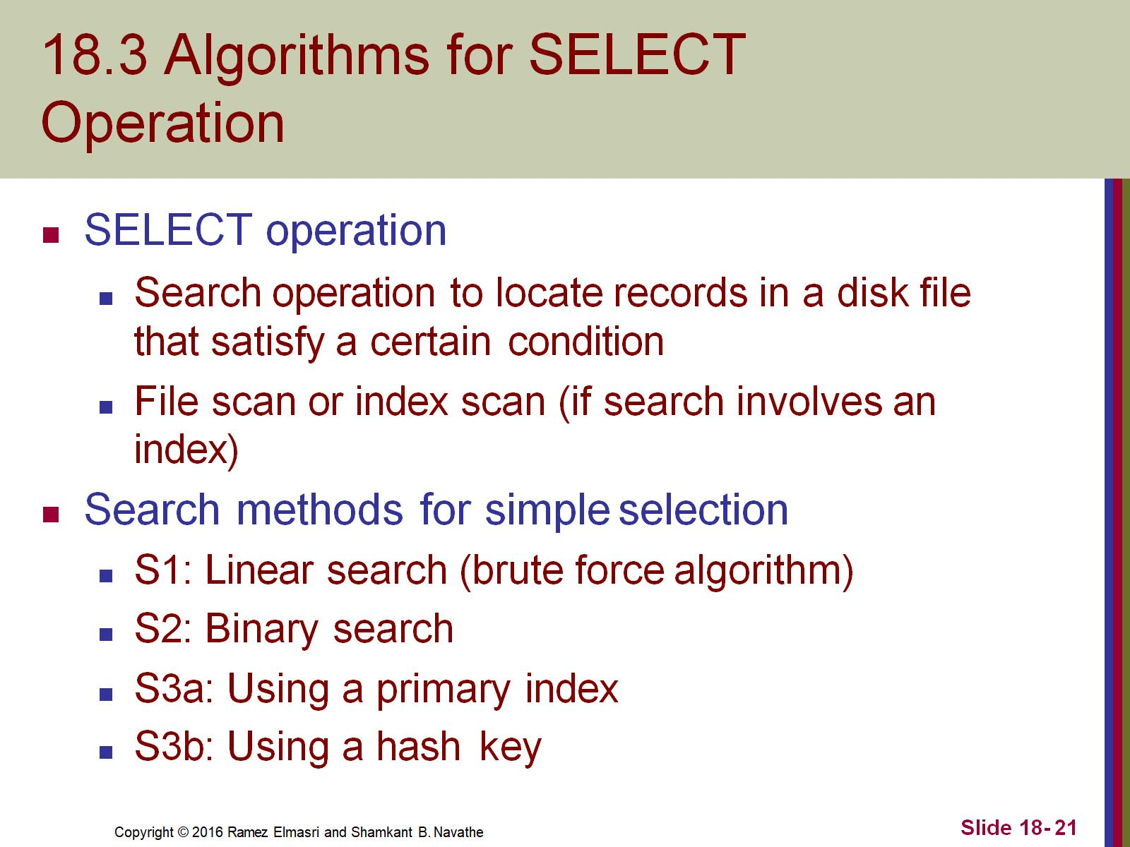
18.3 Algorithms for SELECT Operation

Slide 22
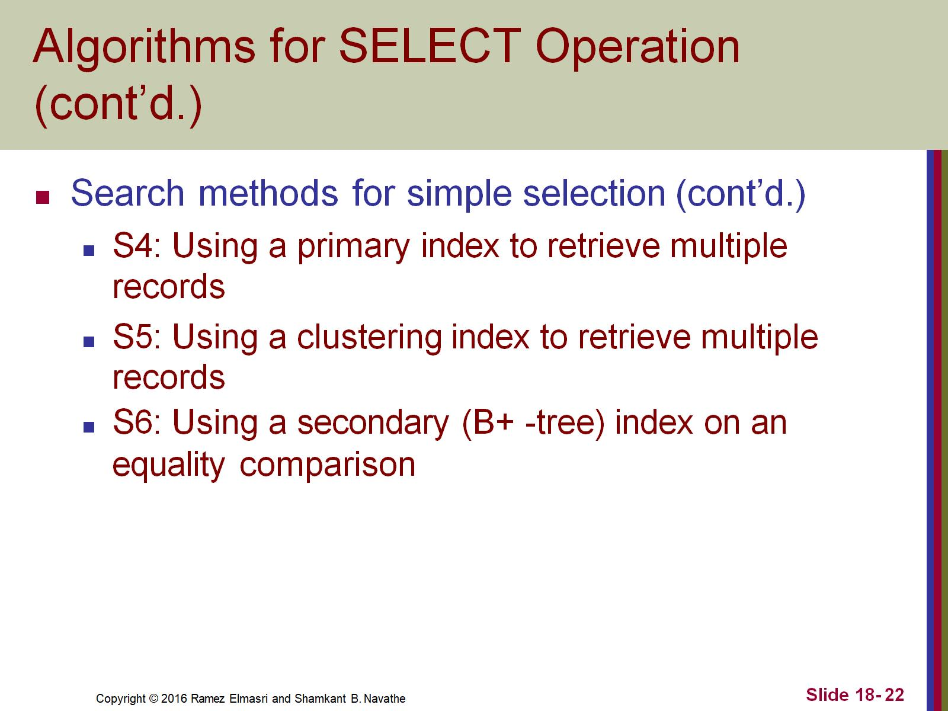
Algorithms for SELECT Operation (cont’d.)

Slide 23
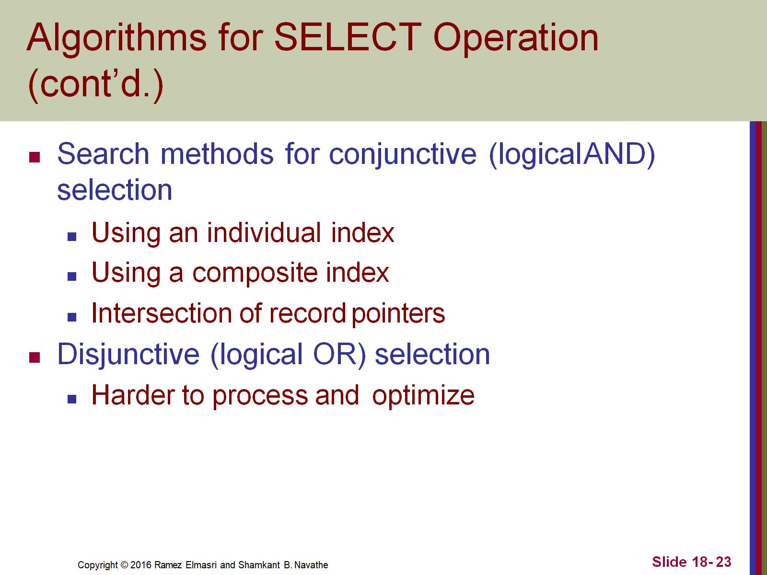
Algorithms for SELECT Operation (cont’d.)

Slide 24
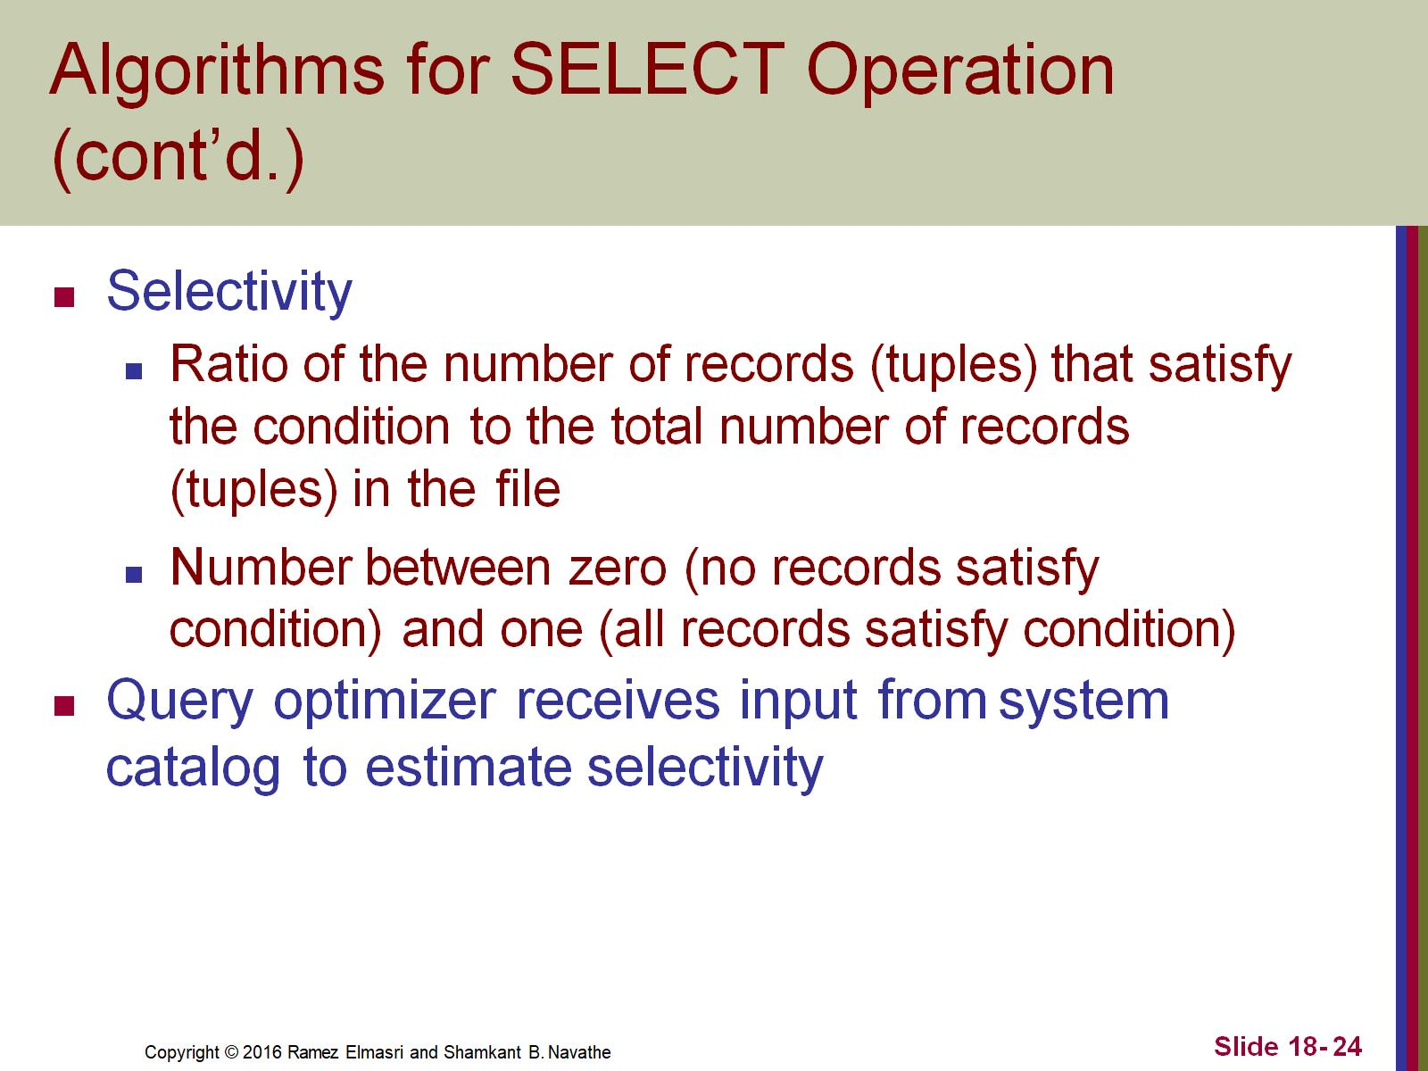
Algorithms for SELECT Operation (cont’d.)

Slide 25
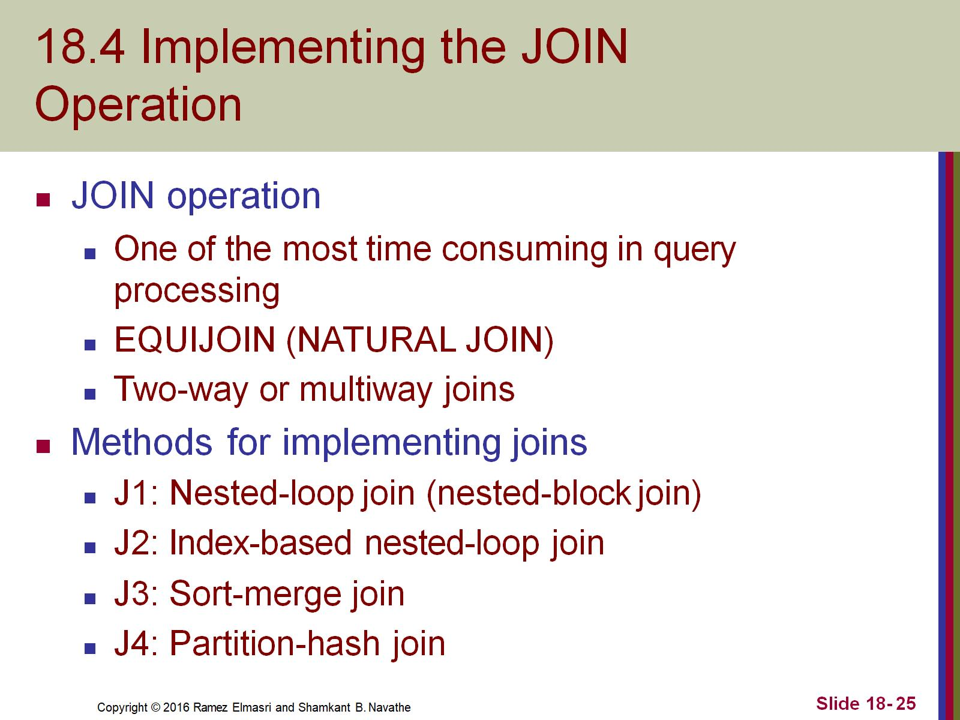
18.4 Implementing the JOIN Operation

Slide 26
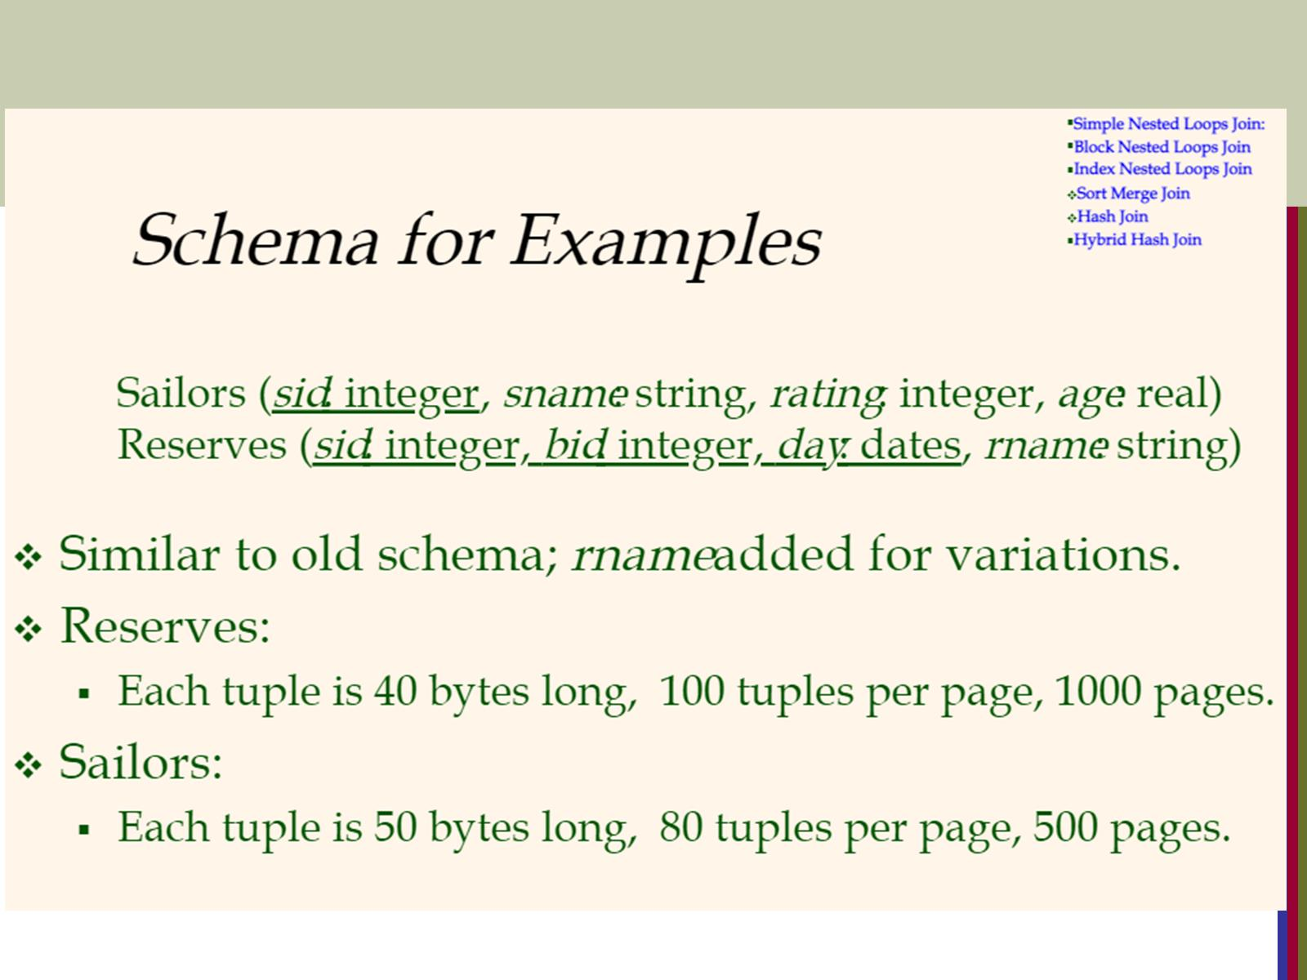

Slide 27
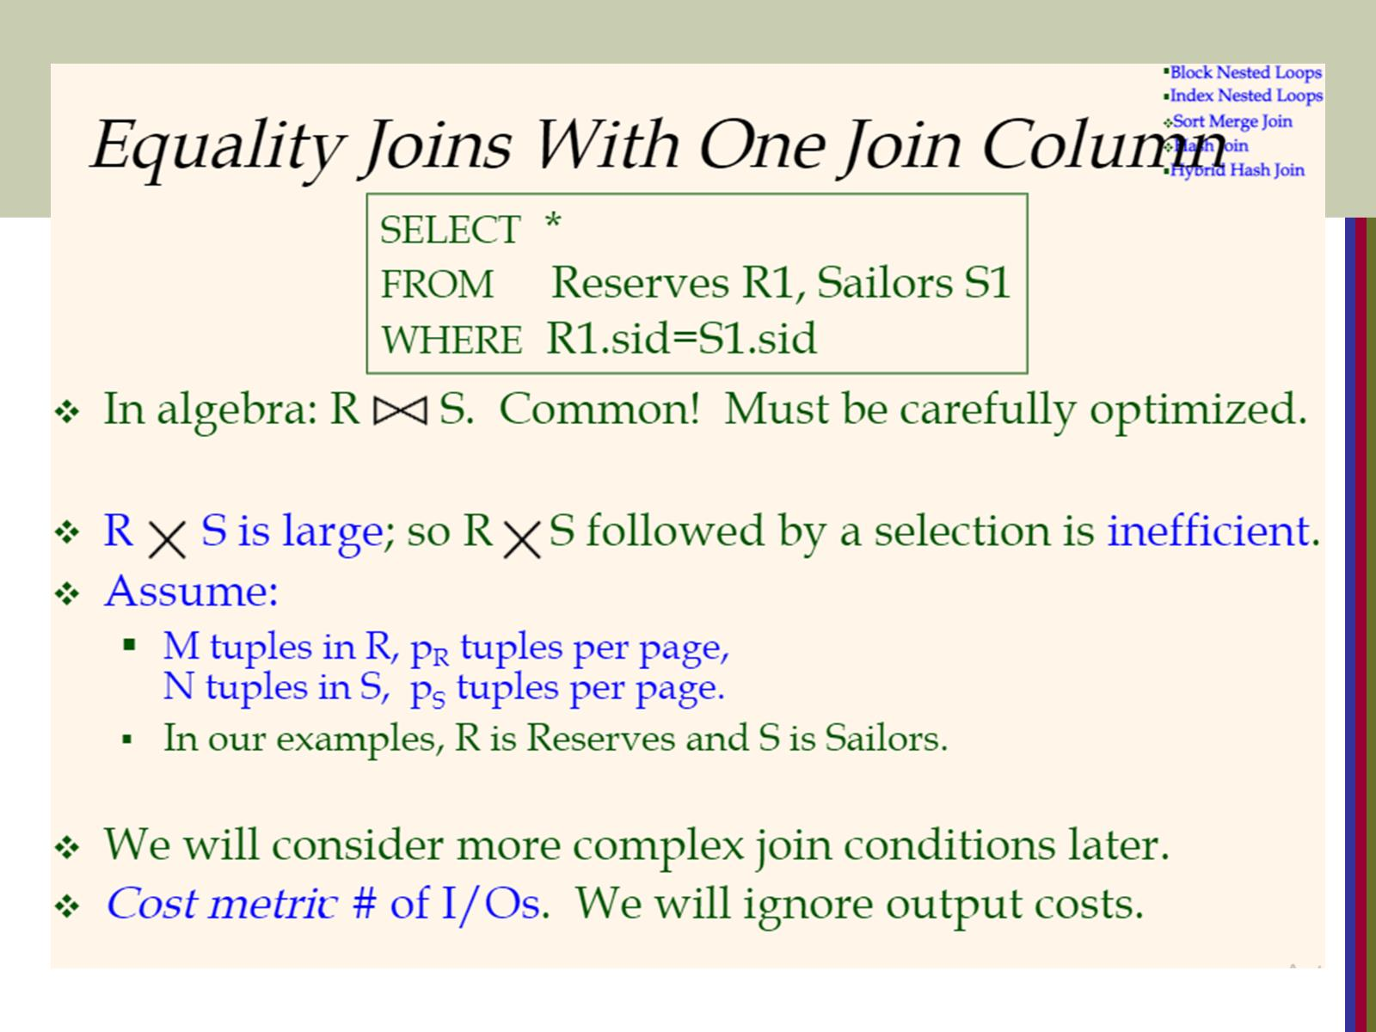

Slide 28
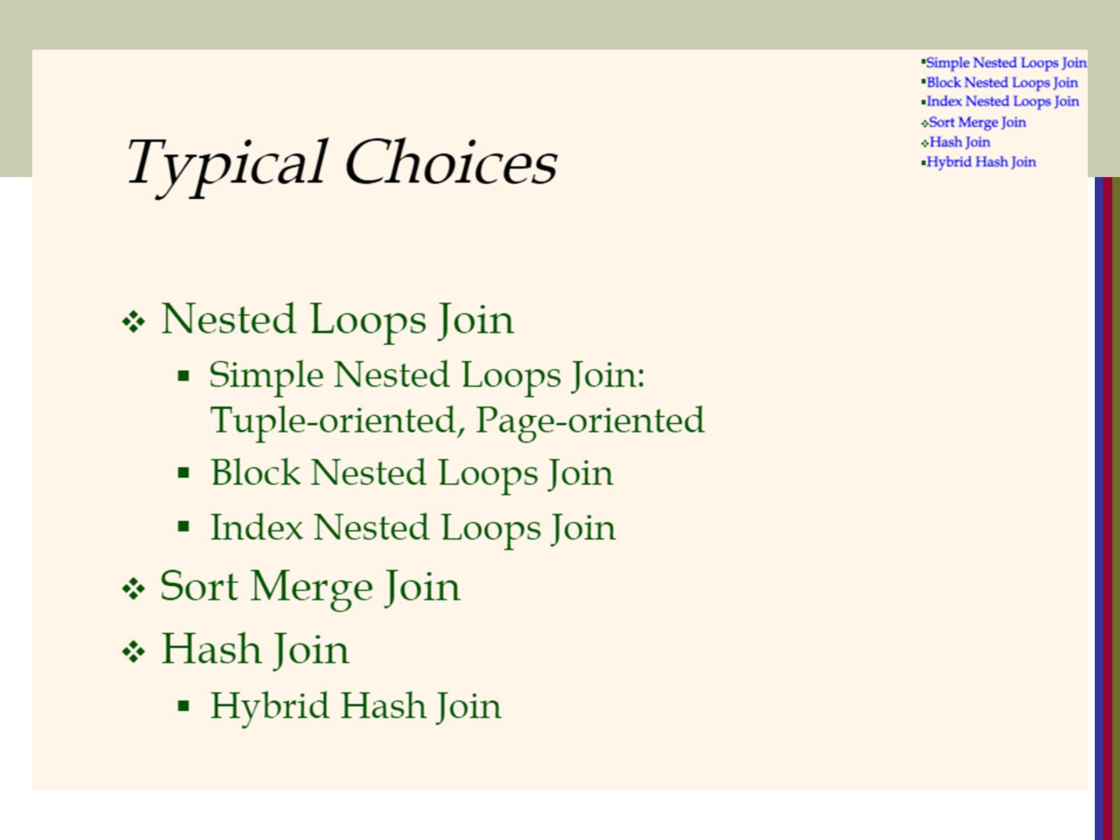

Slide 29
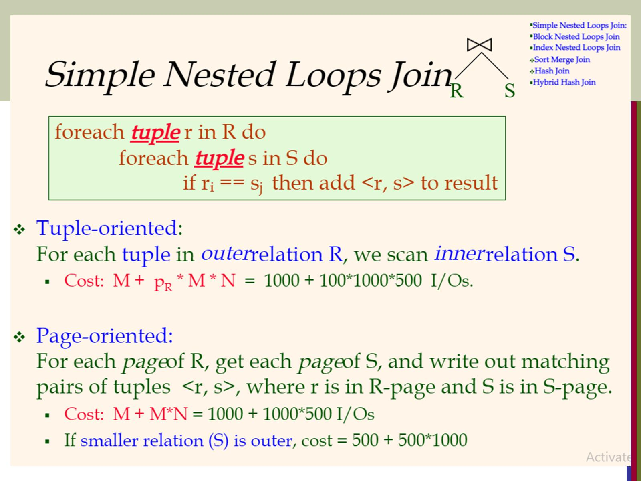

Slide 30
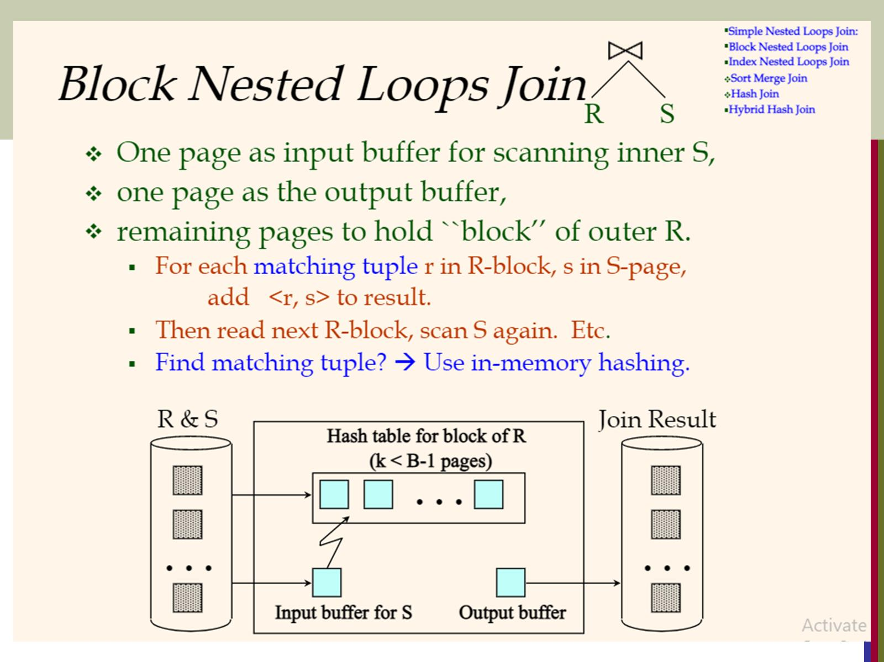

Slide 31
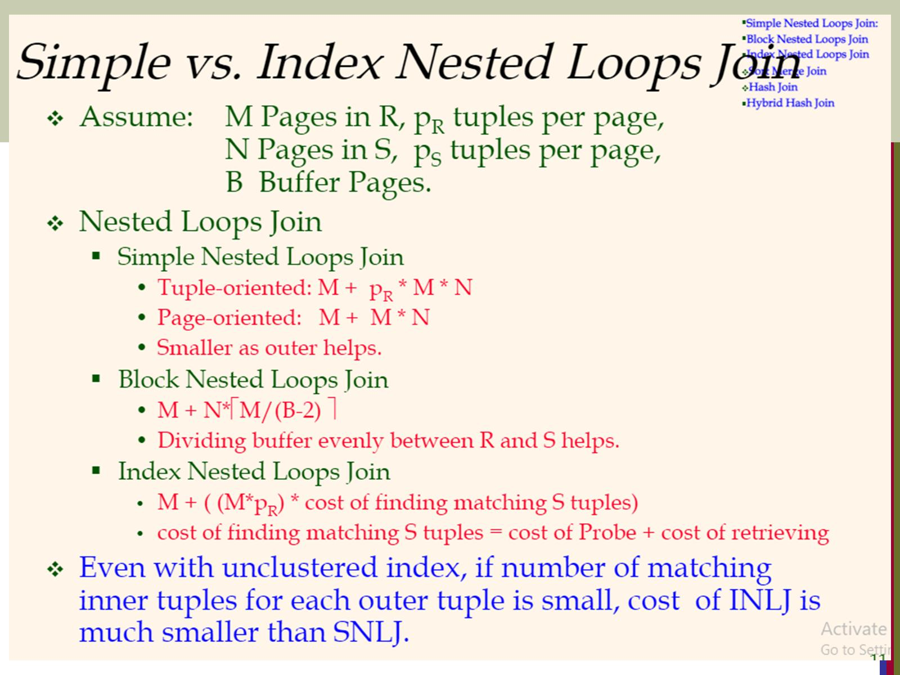

Slide 32
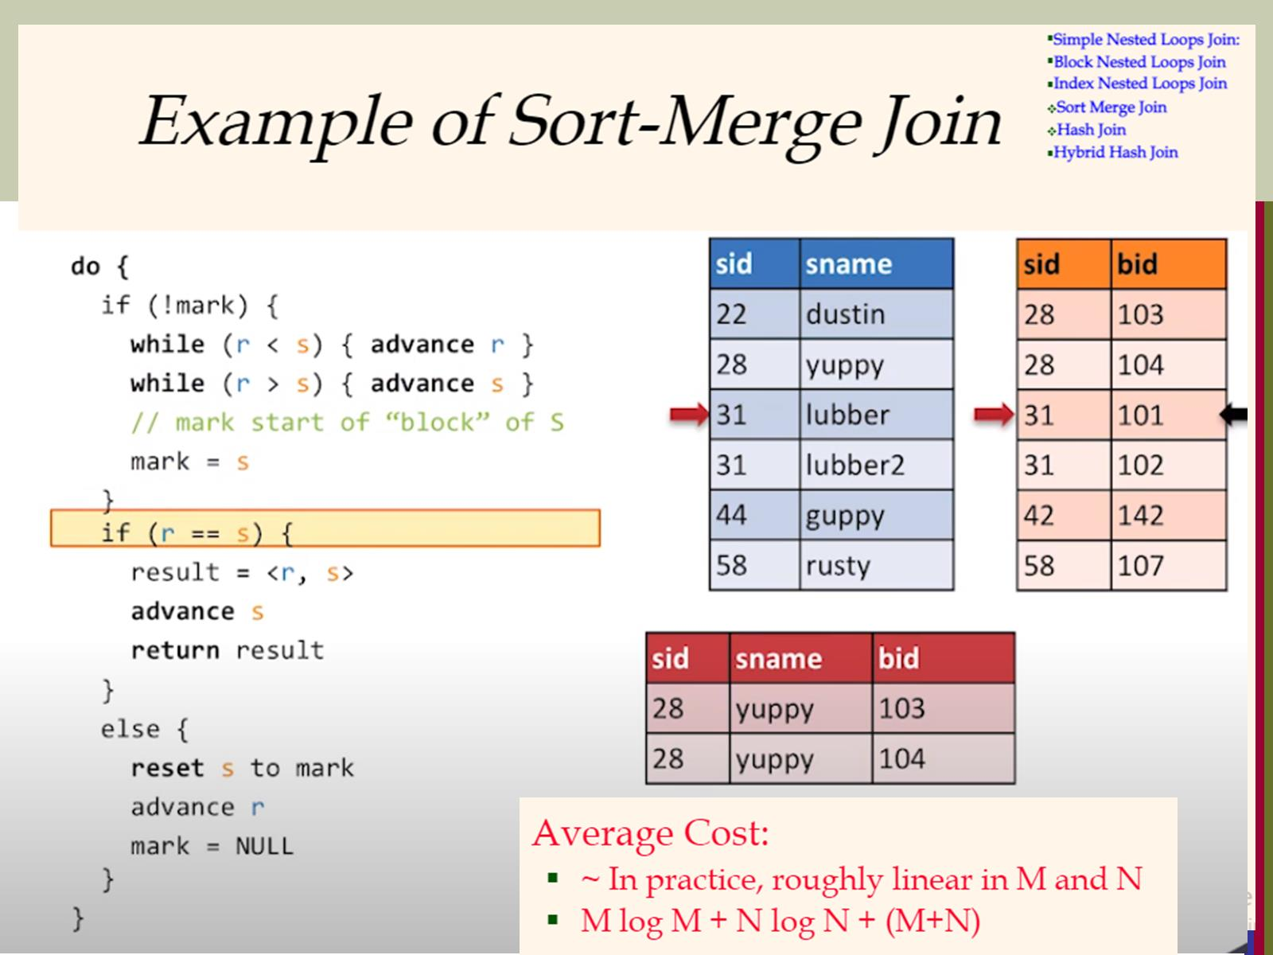

Slide 33
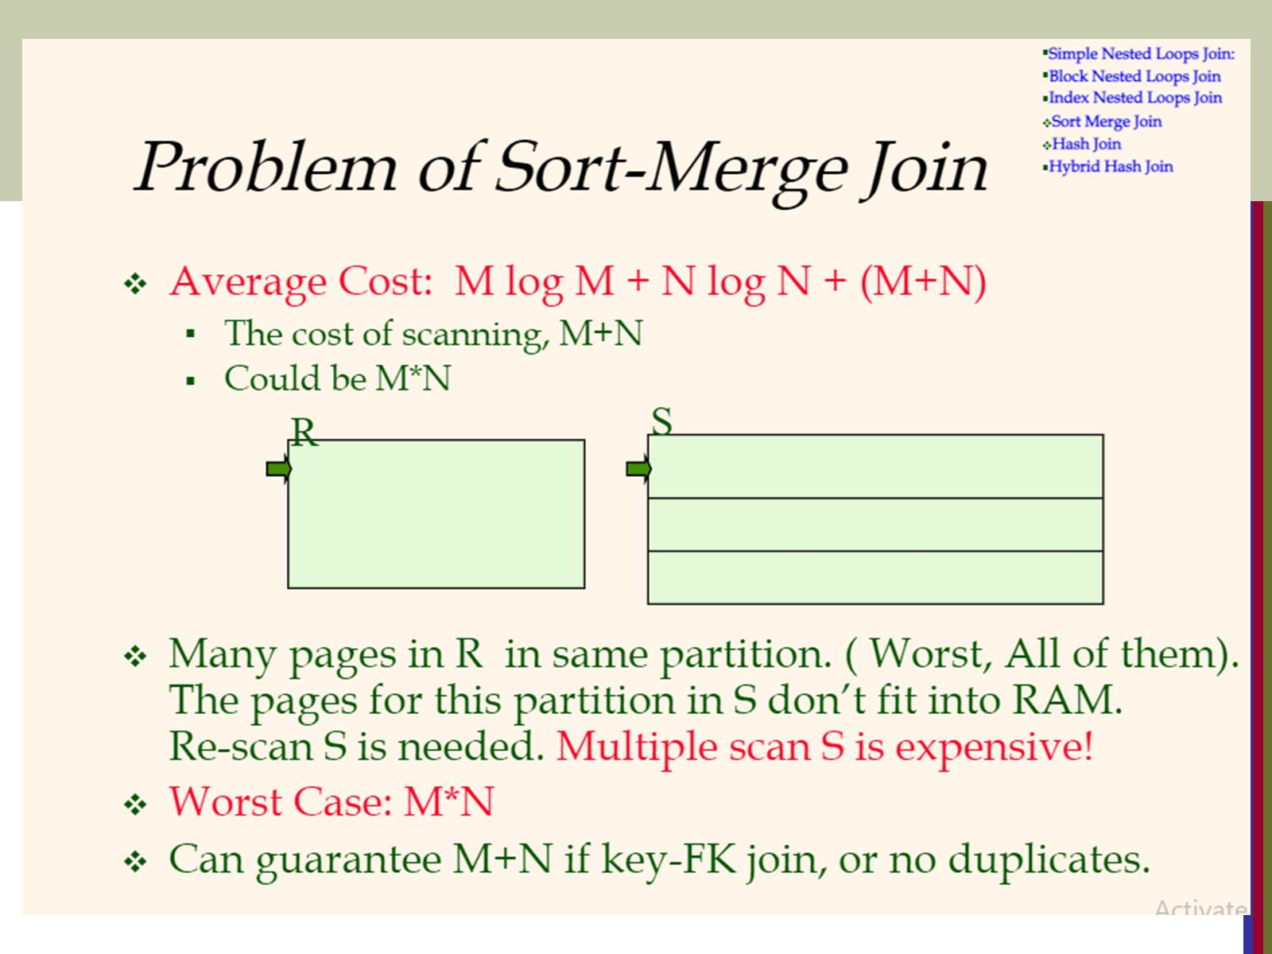

Slide 34
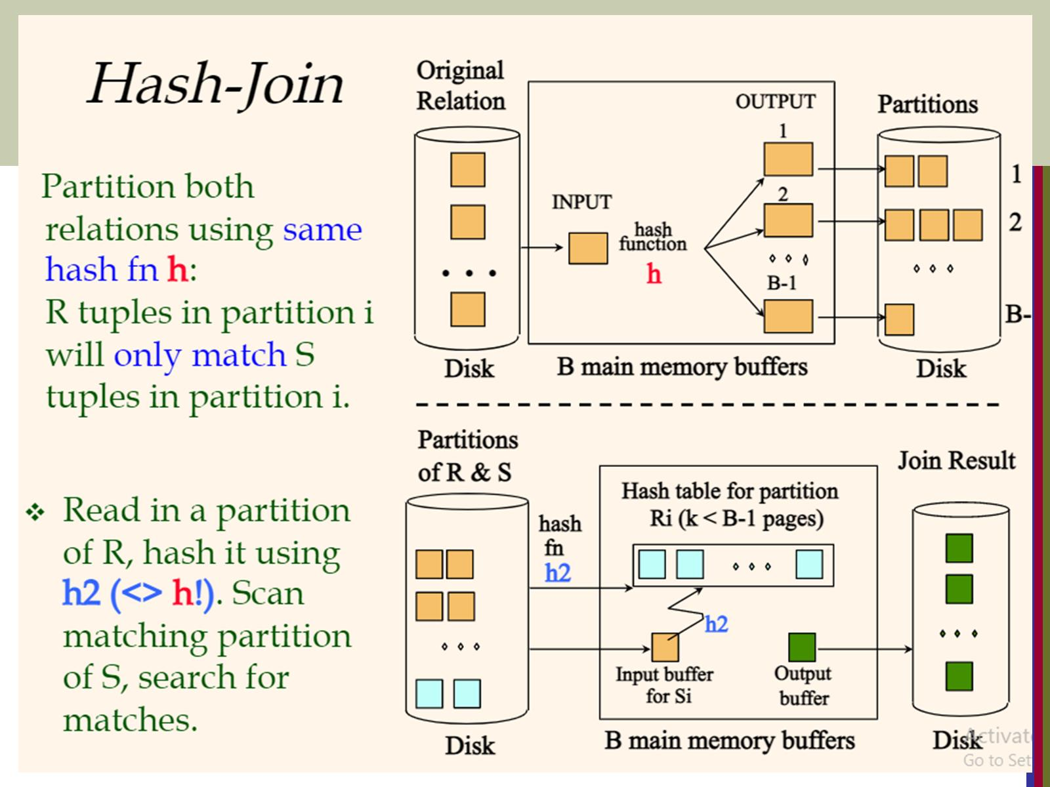

Slide 35
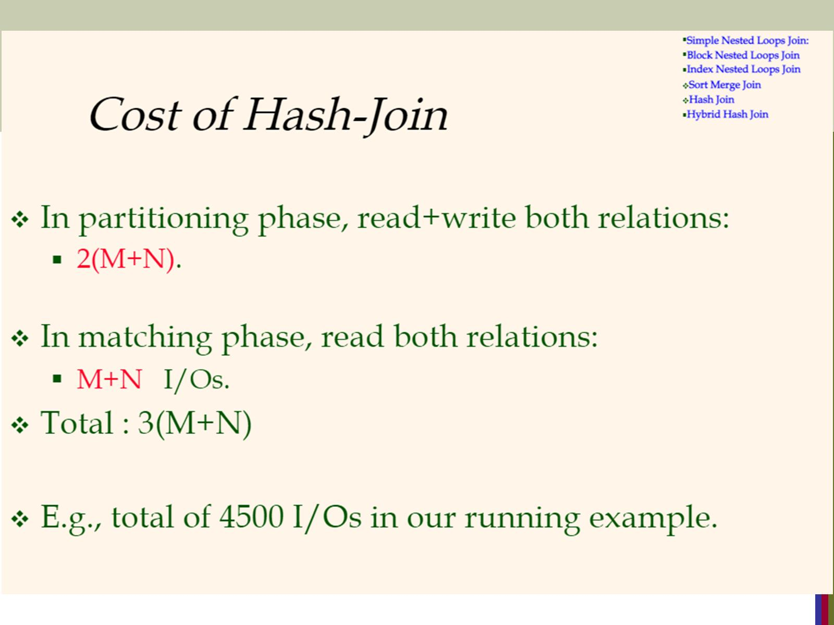

Slide 36
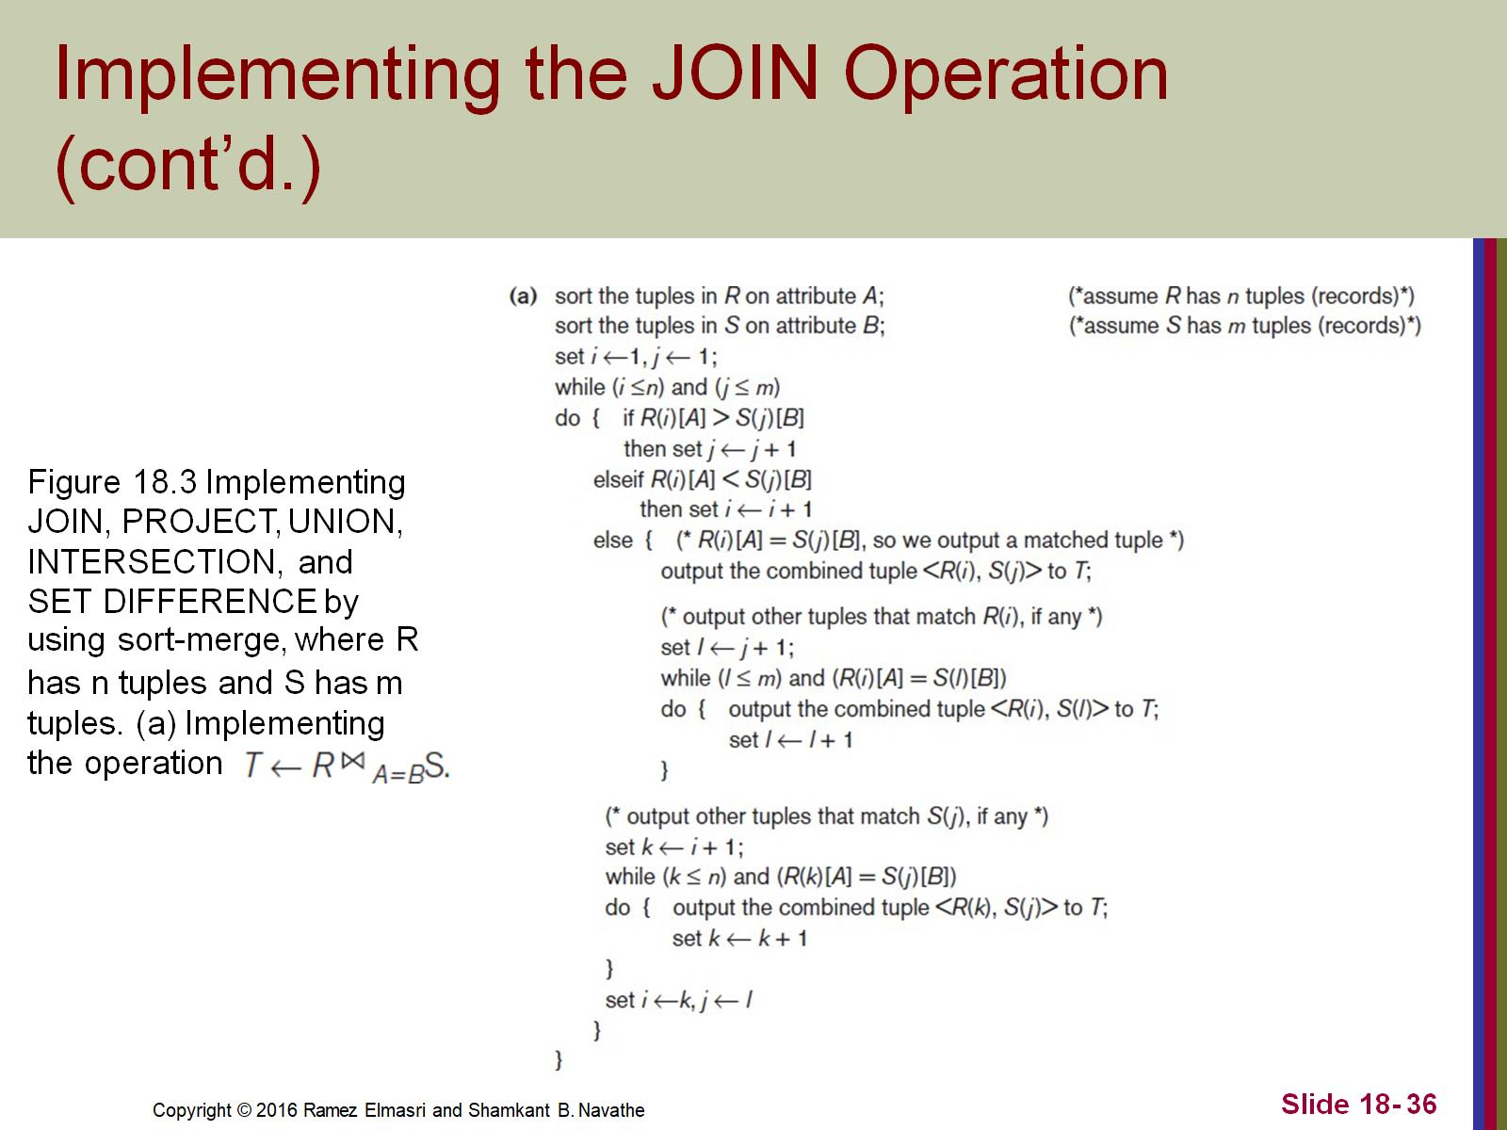
Implementing the JOIN Operation (cont’d.)

Slide 37
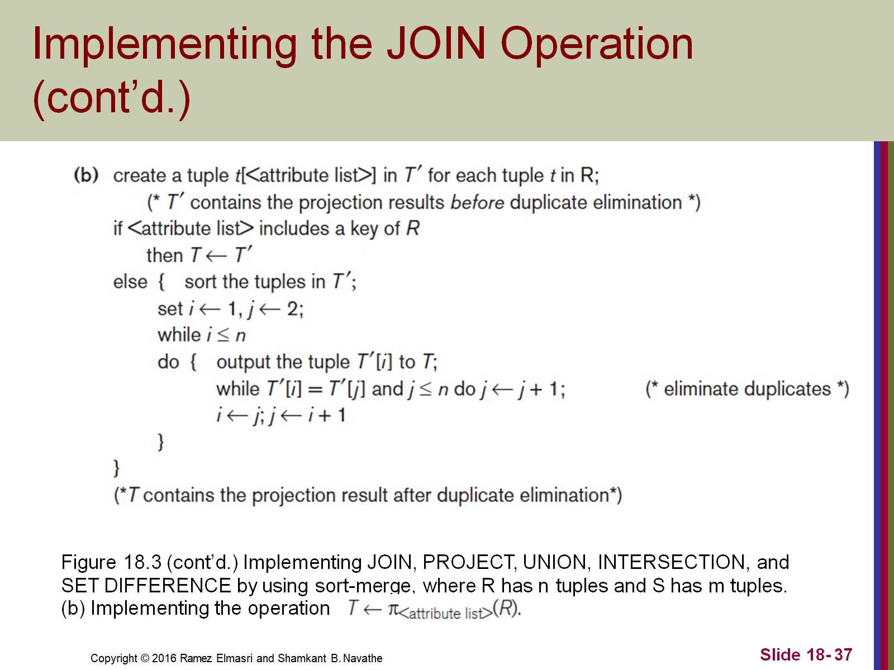
Implementing the JOIN Operation (cont’d.)

Slide 38
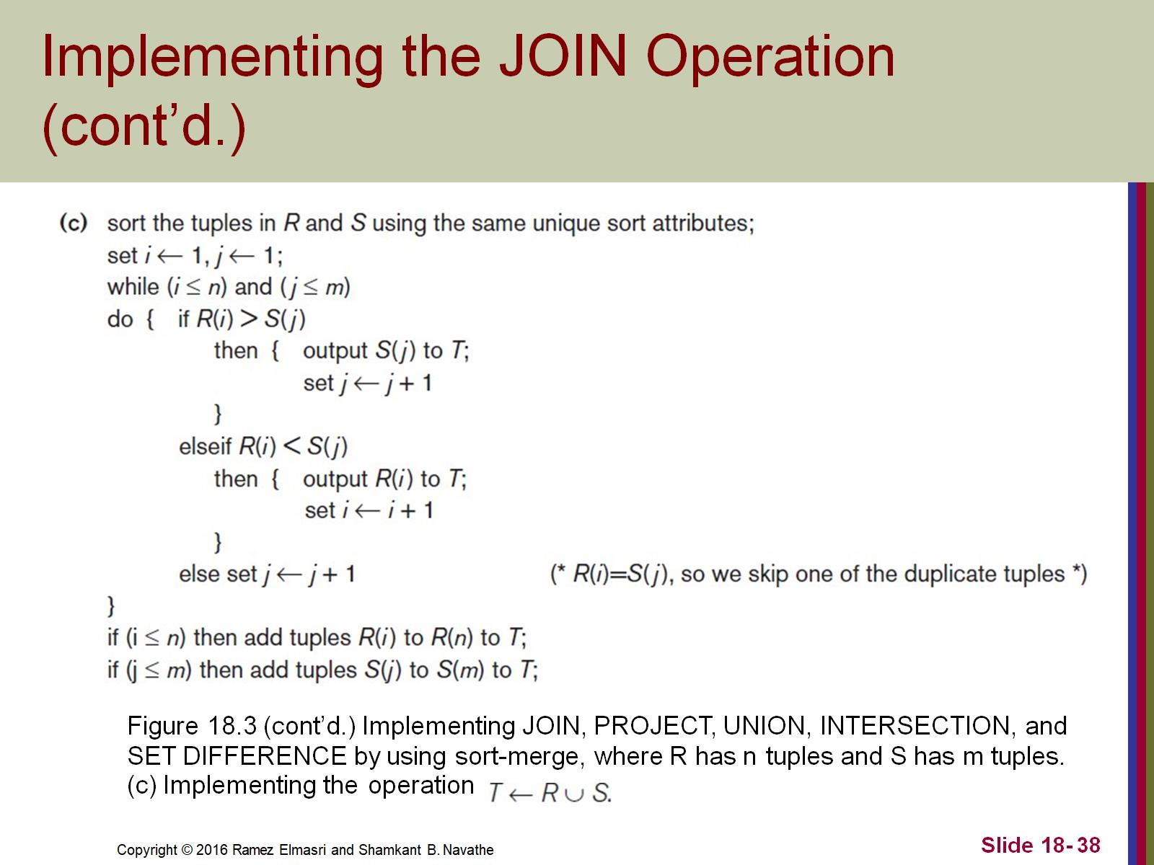
Implementing the JOIN Operation (cont’d.)

Slide 39
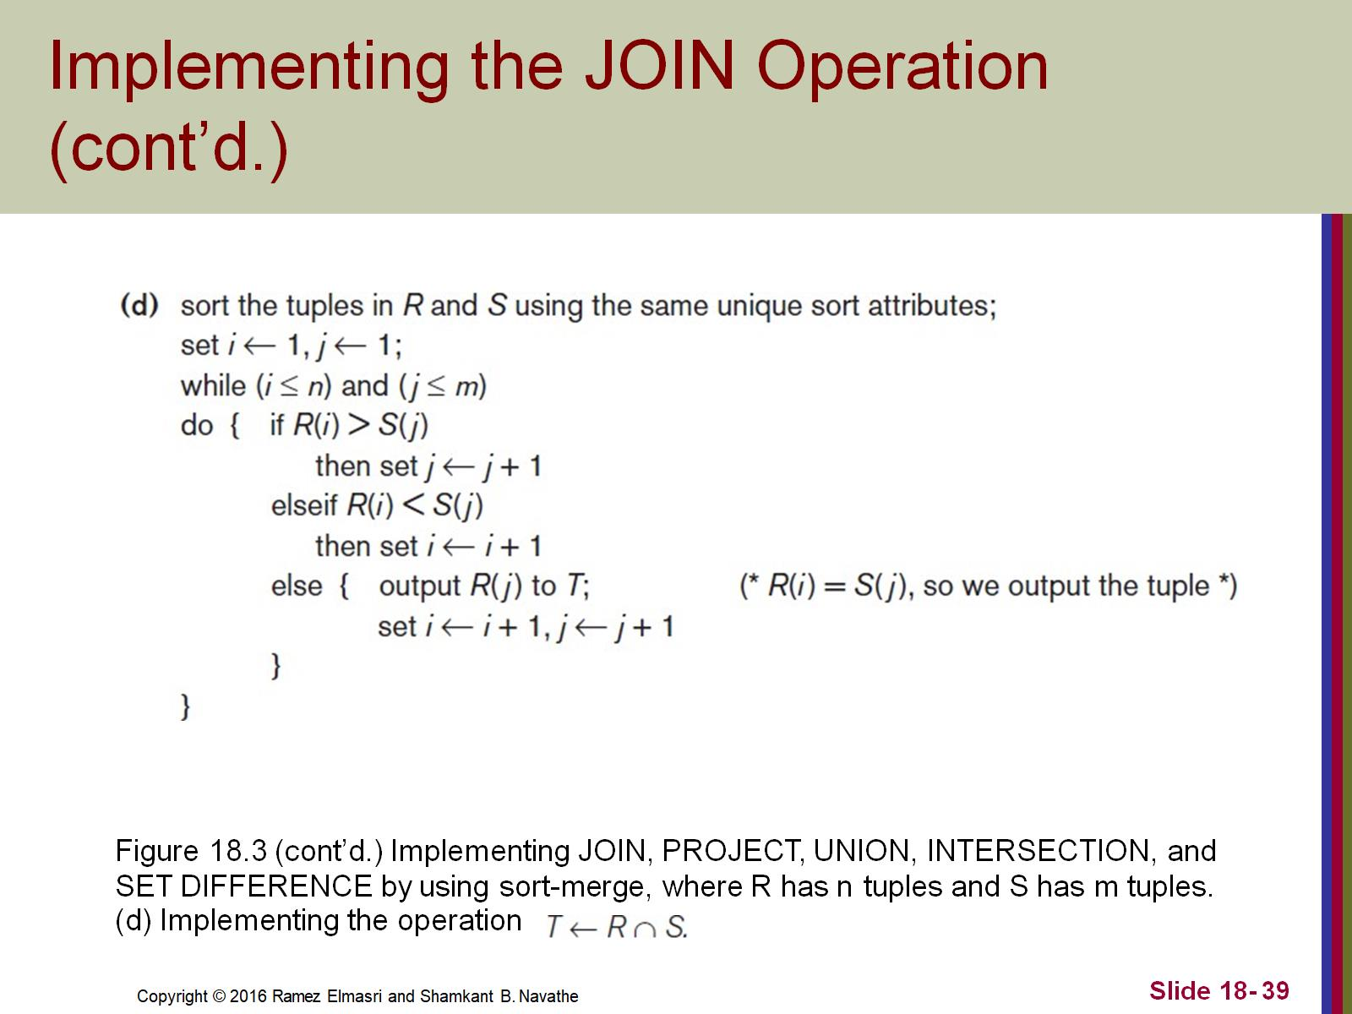
Implementing the JOIN Operation (cont’d.)

Slide 40
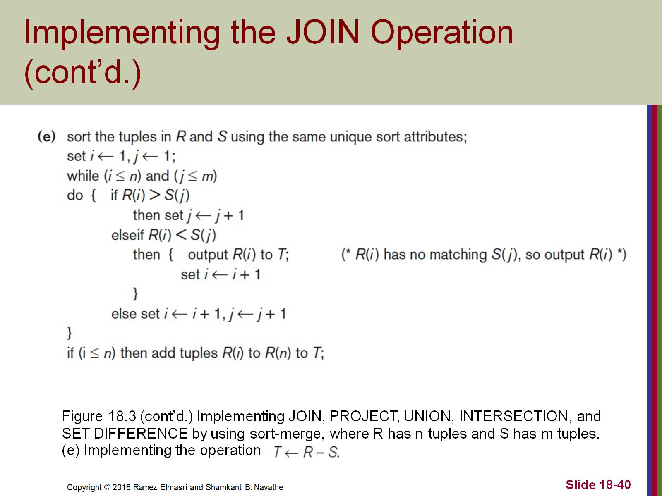
Implementing the JOIN Operation (cont’d.)

Slide 41
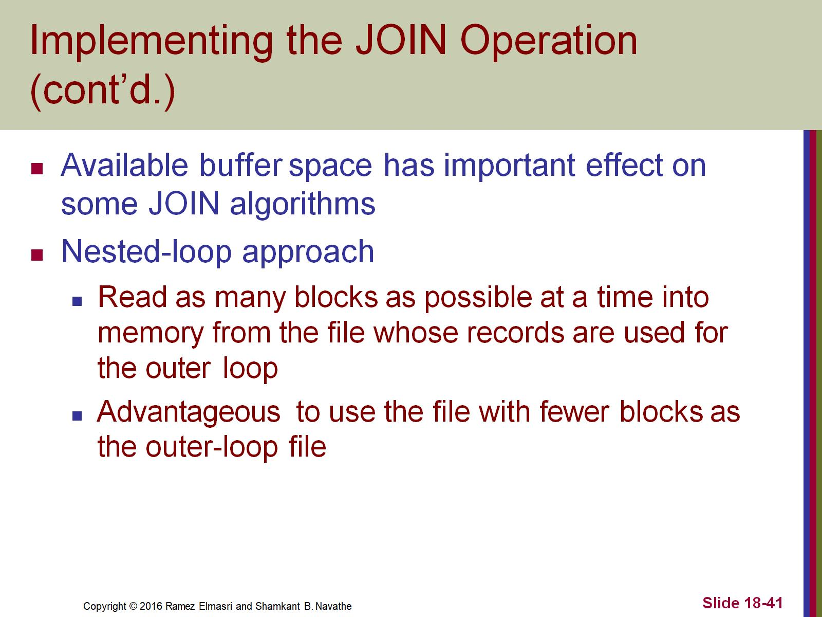
Implementing the JOIN Operation (cont’d.)

Slide 42
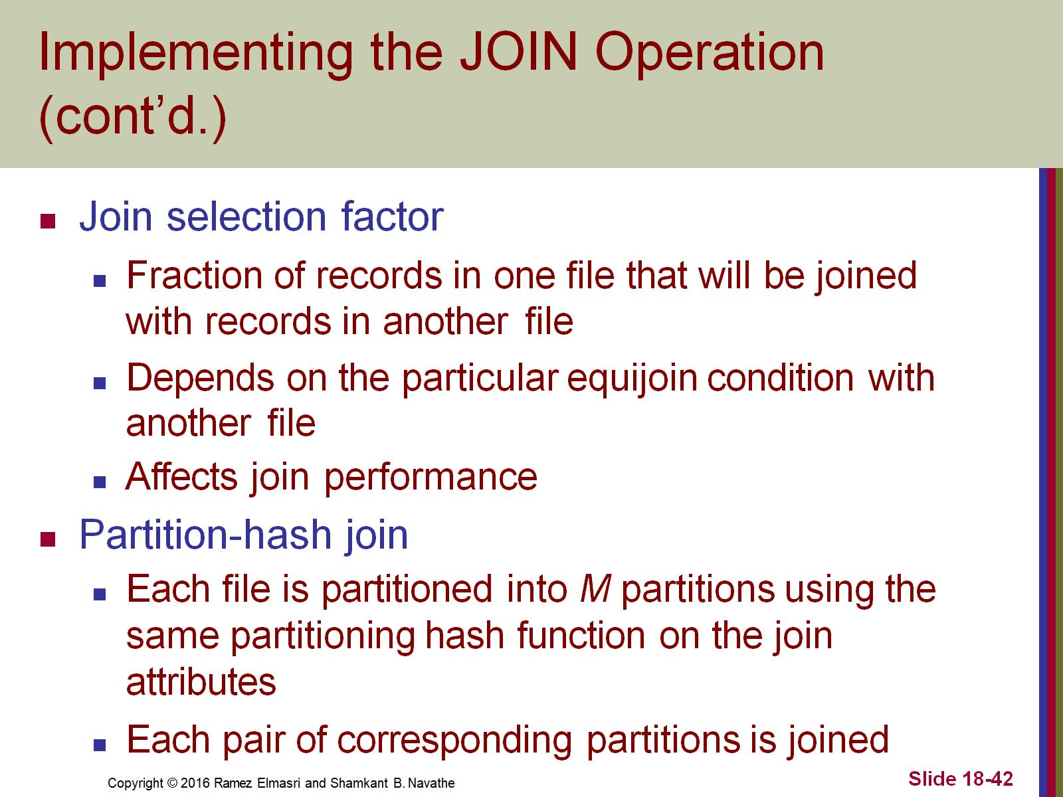
Implementing the JOIN Operation (cont’d.)

Slide 43
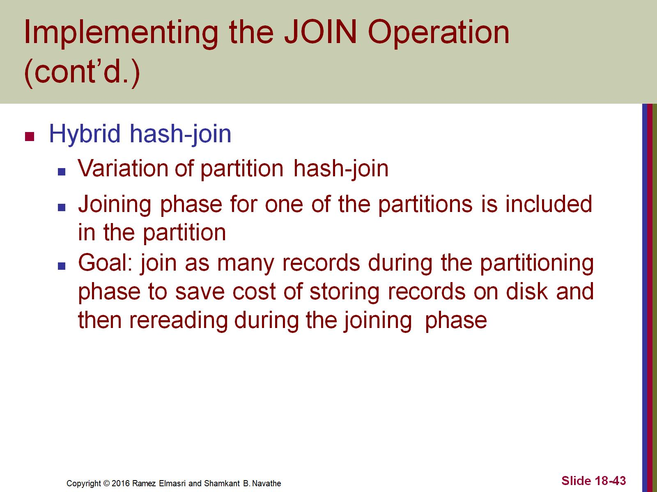
Implementing the JOIN Operation (cont’d.)

Slide 44
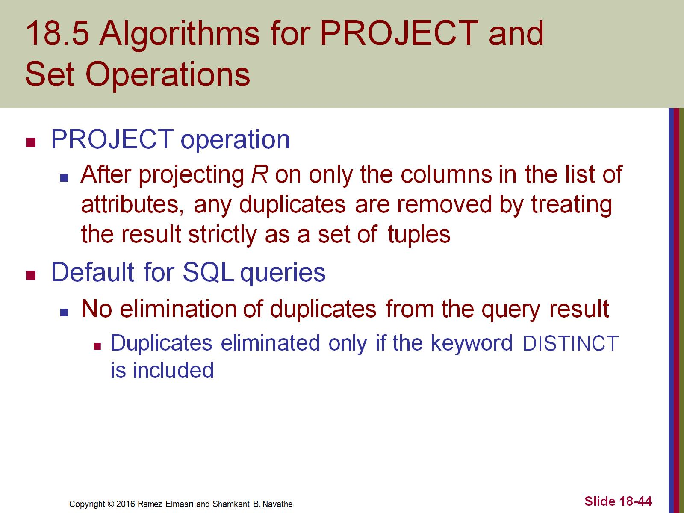
18.5 Algorithms for PROJECT and Set Operations

Slide 45
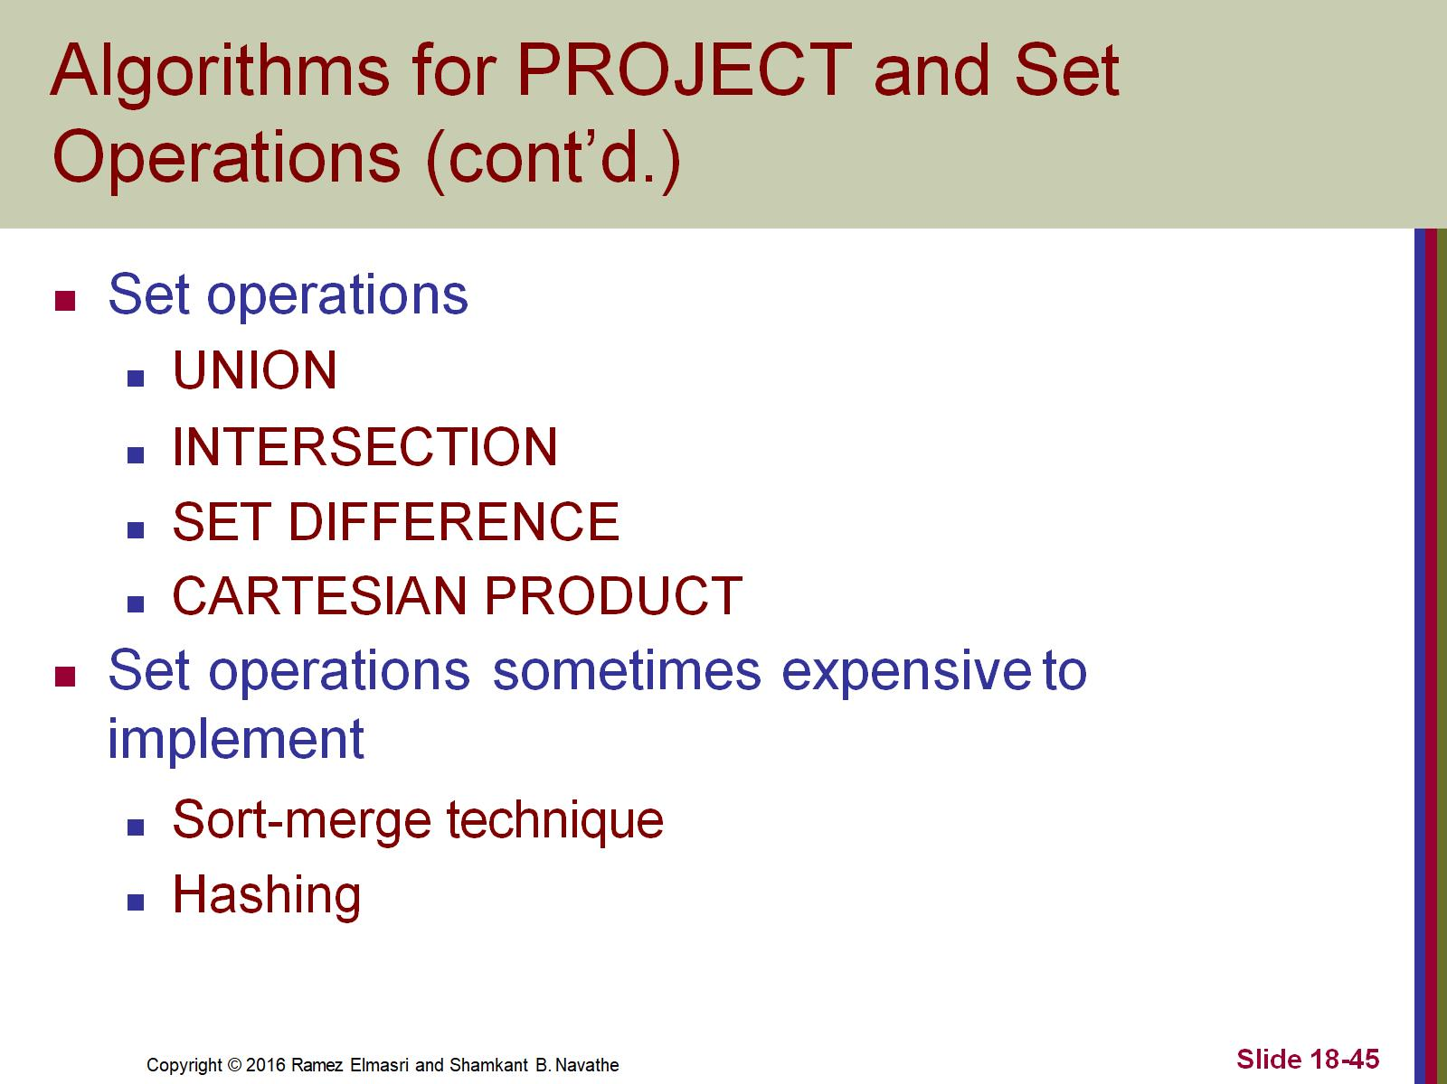
Algorithms for PROJECT and Set Operations (cont’d.)

Slide 46
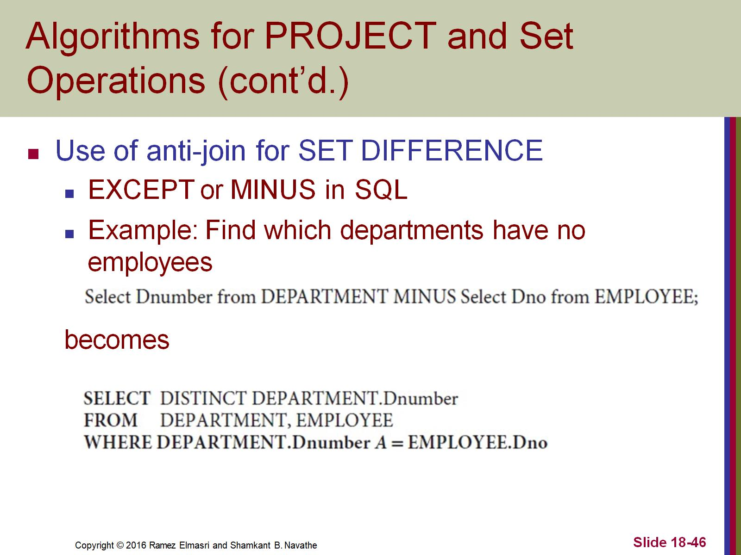
Algorithms for PROJECT and Set Operations (cont’d.)

Slide 47
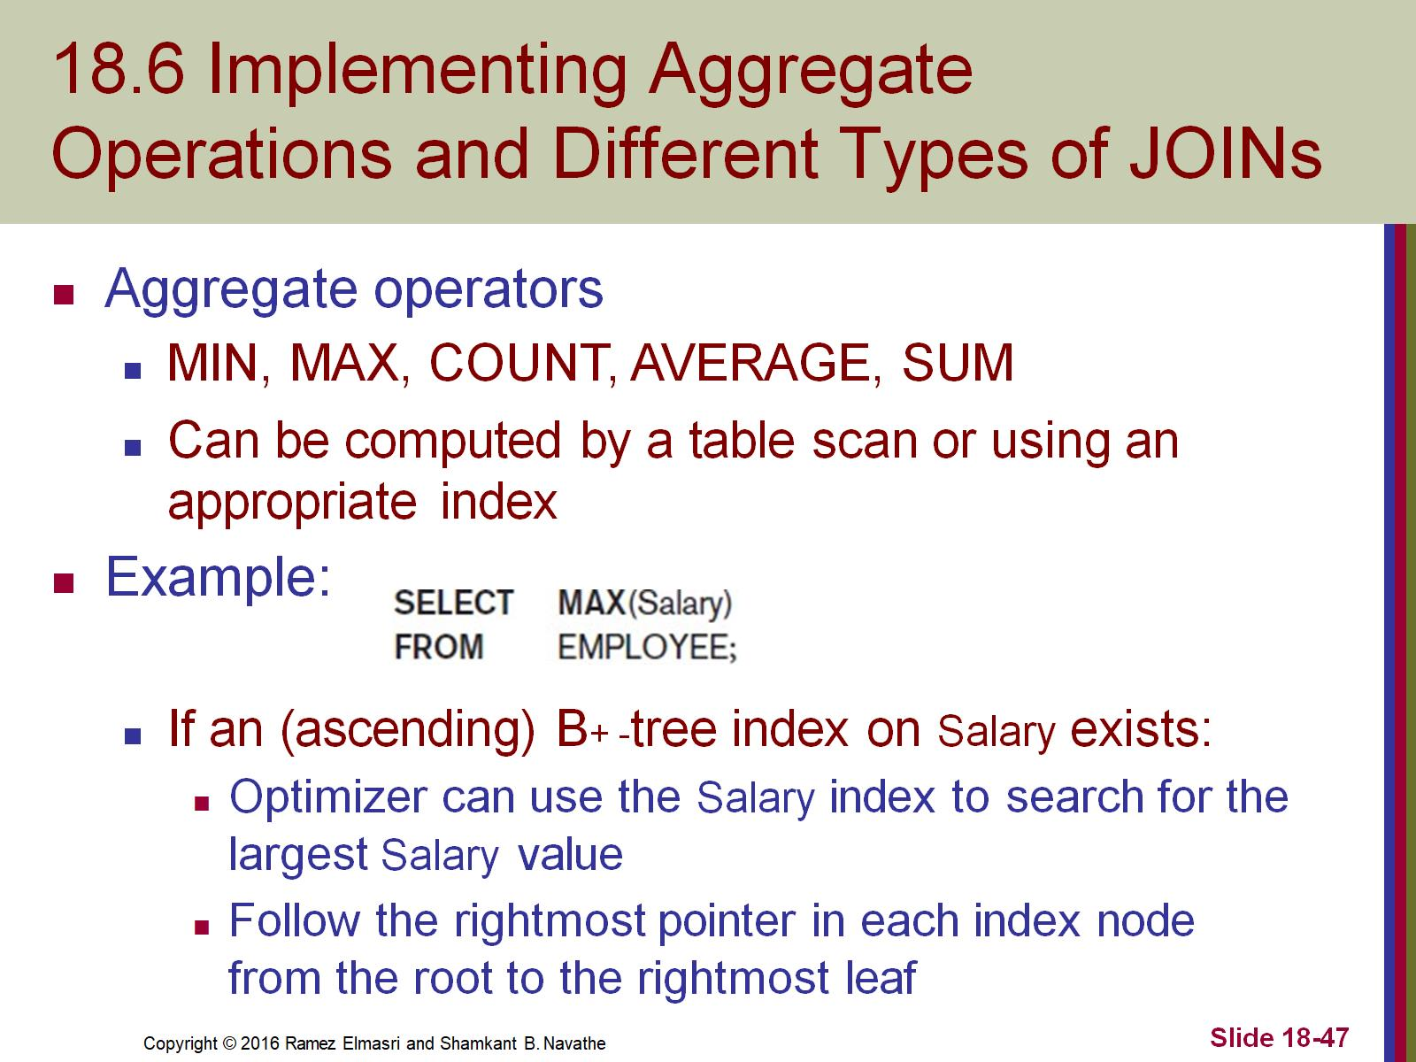
18.6 Implementing Aggregate Operations and Different Types of JOINs

Slide 48
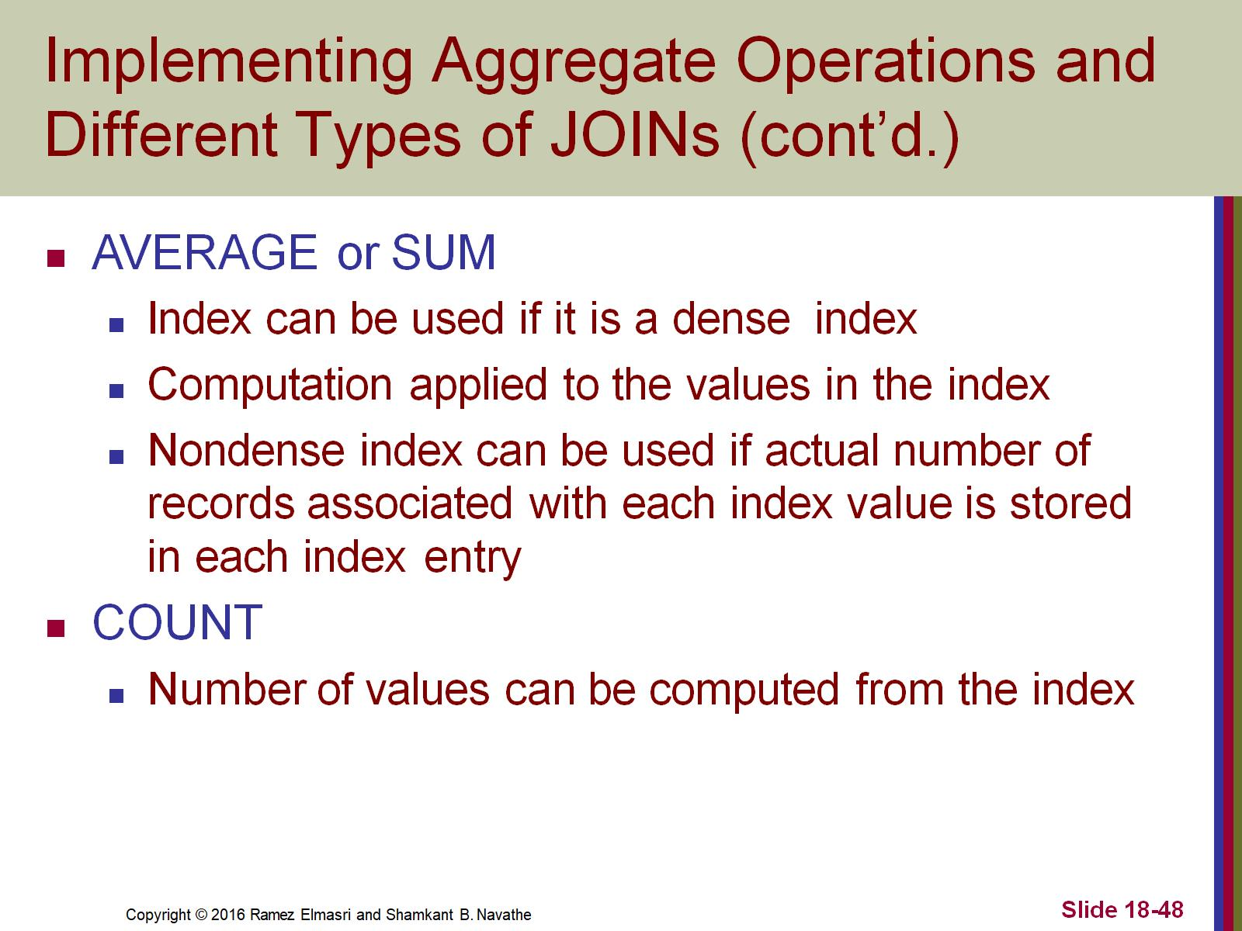
Implementing Aggregate Operations and Different Types of JOINs (cont’d.)

Slide 49
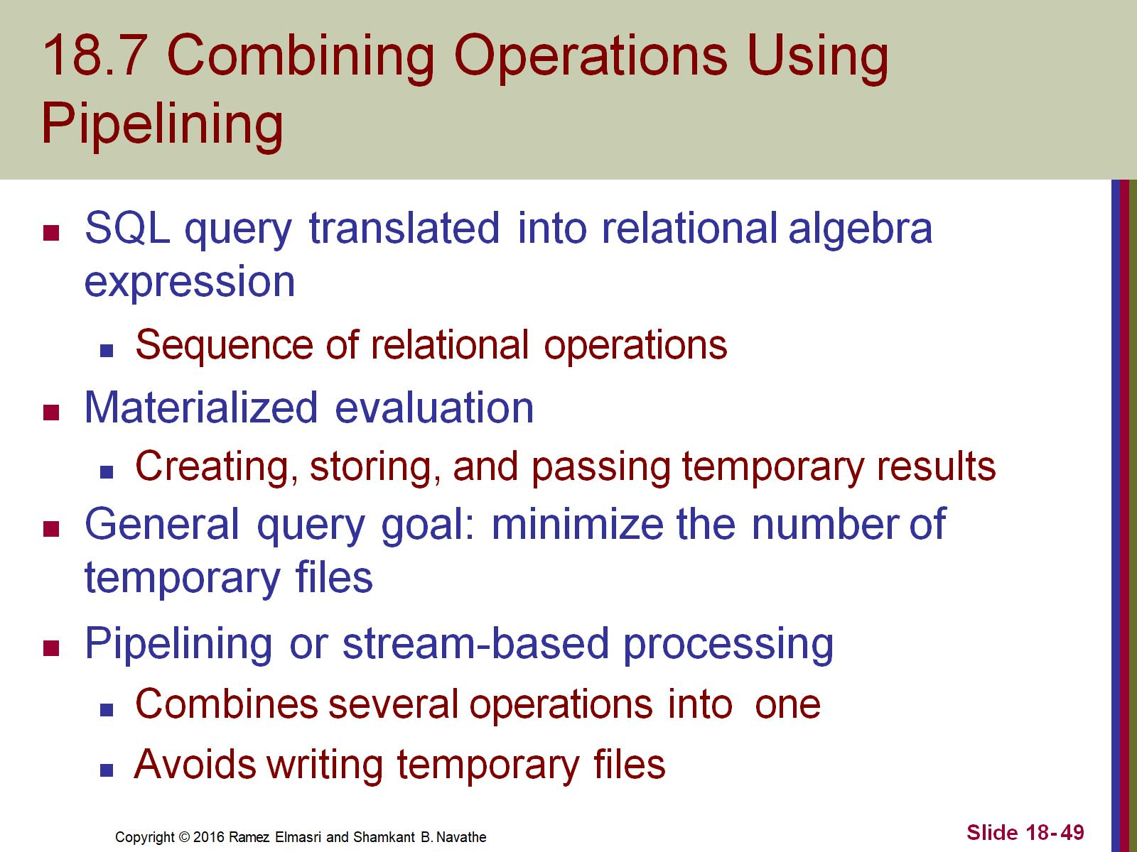
18.7 Combining Operations Using Pipelining

Slide 50
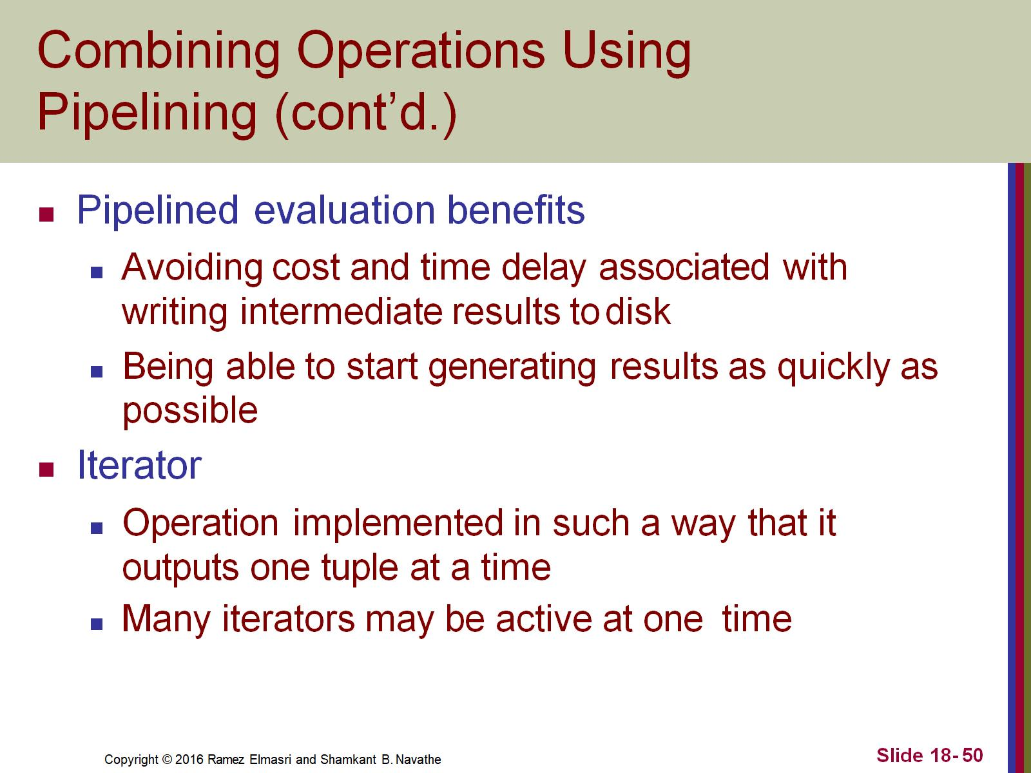
Combining Operations Using Pipelining (cont’d.)

Slide 51
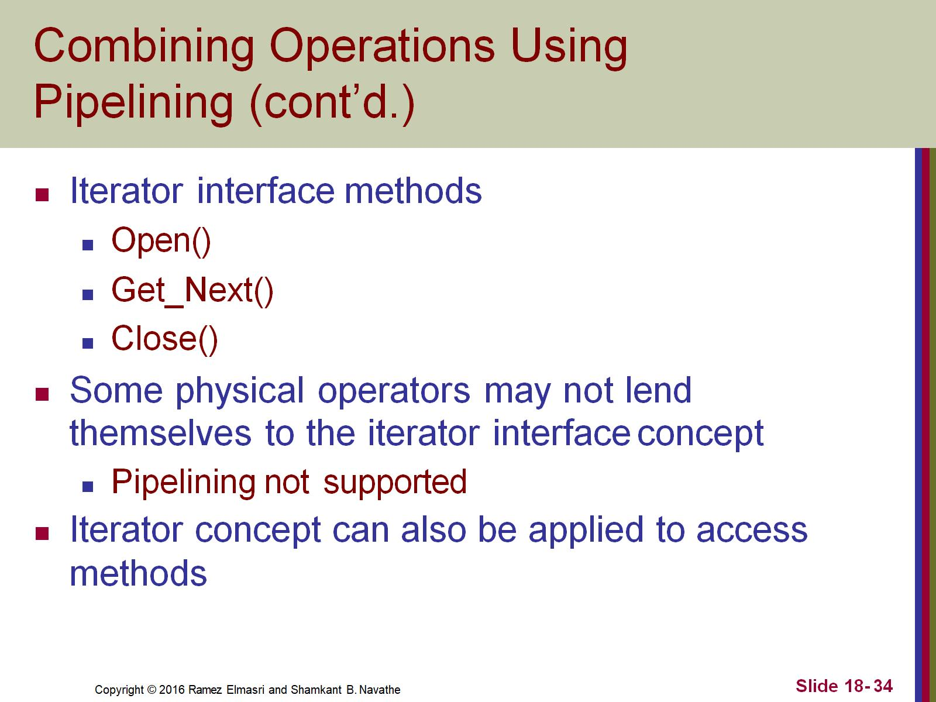
Combining Operations Using Pipelining (cont’d.)

